Slide 1
VespAlert

Slide 2
Hornet Dataset

Slide 3
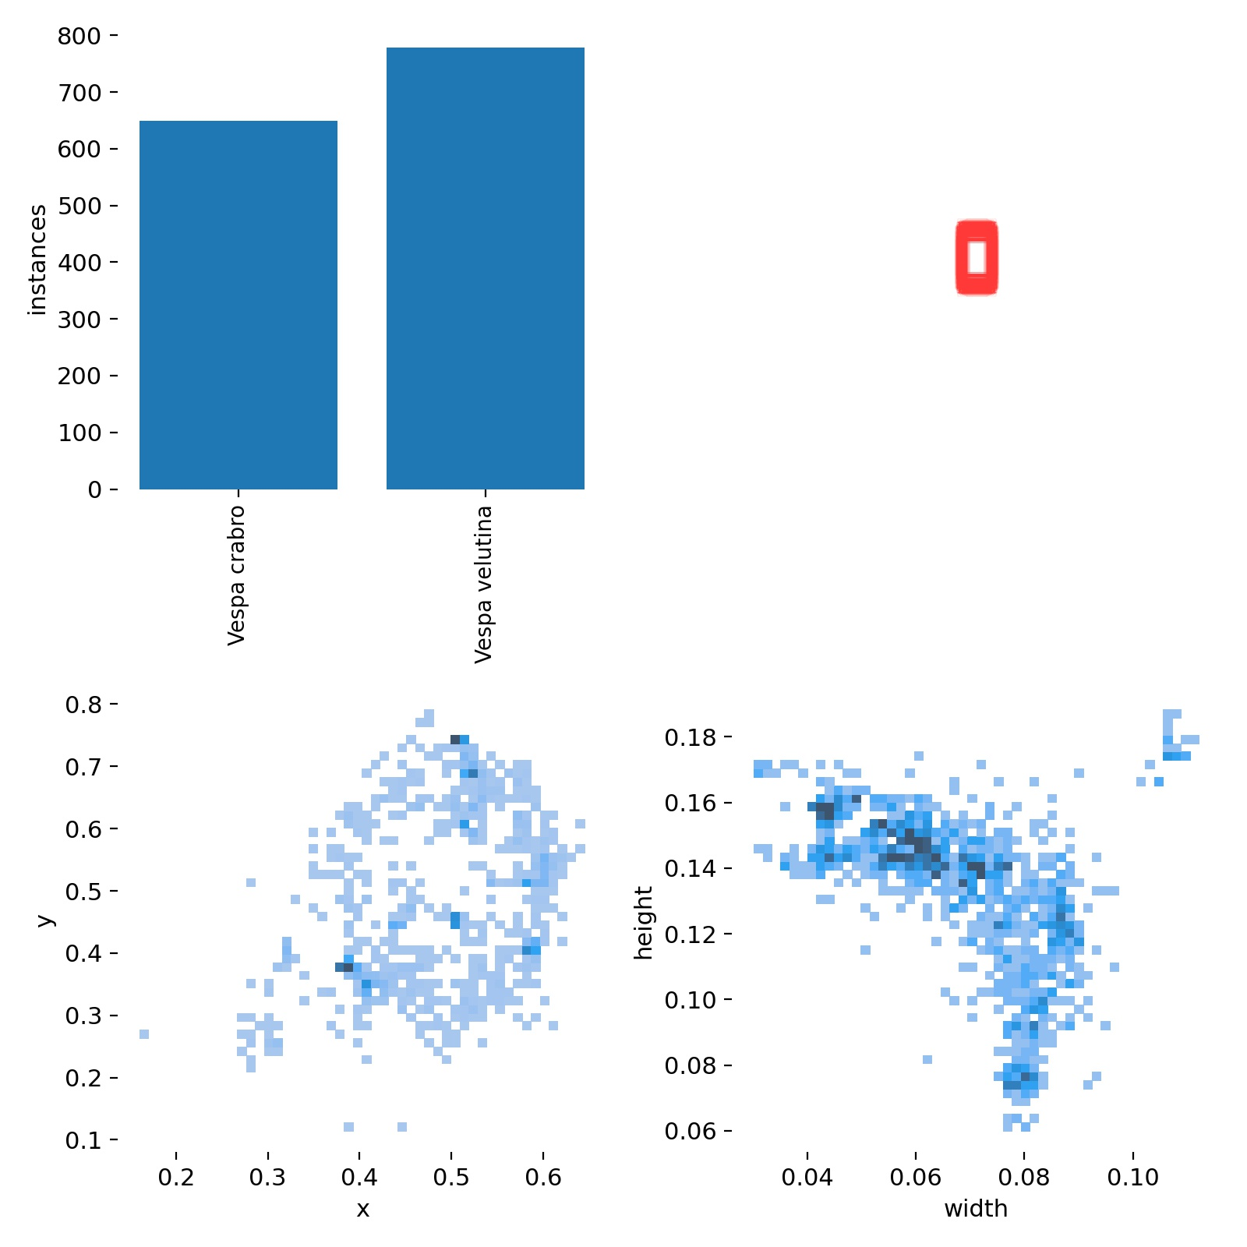
Hornet Dataset
Pete’s kitchen hornet
1811 images
0-3 labels per image
2 classes:
Vespa velutina // Vespa crabro

Slide 4
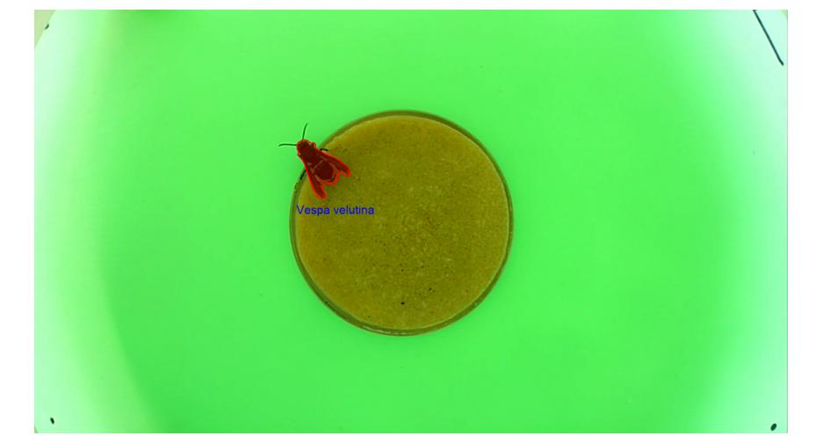
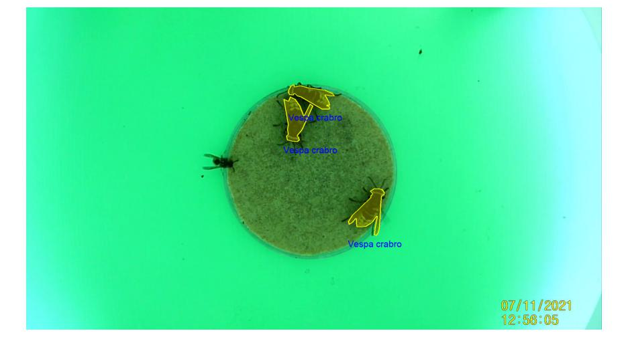
Hornet Dataset
Polygonal labels
Overlapping
Different backgrounds
Timestamps
Other insects

Slide 5
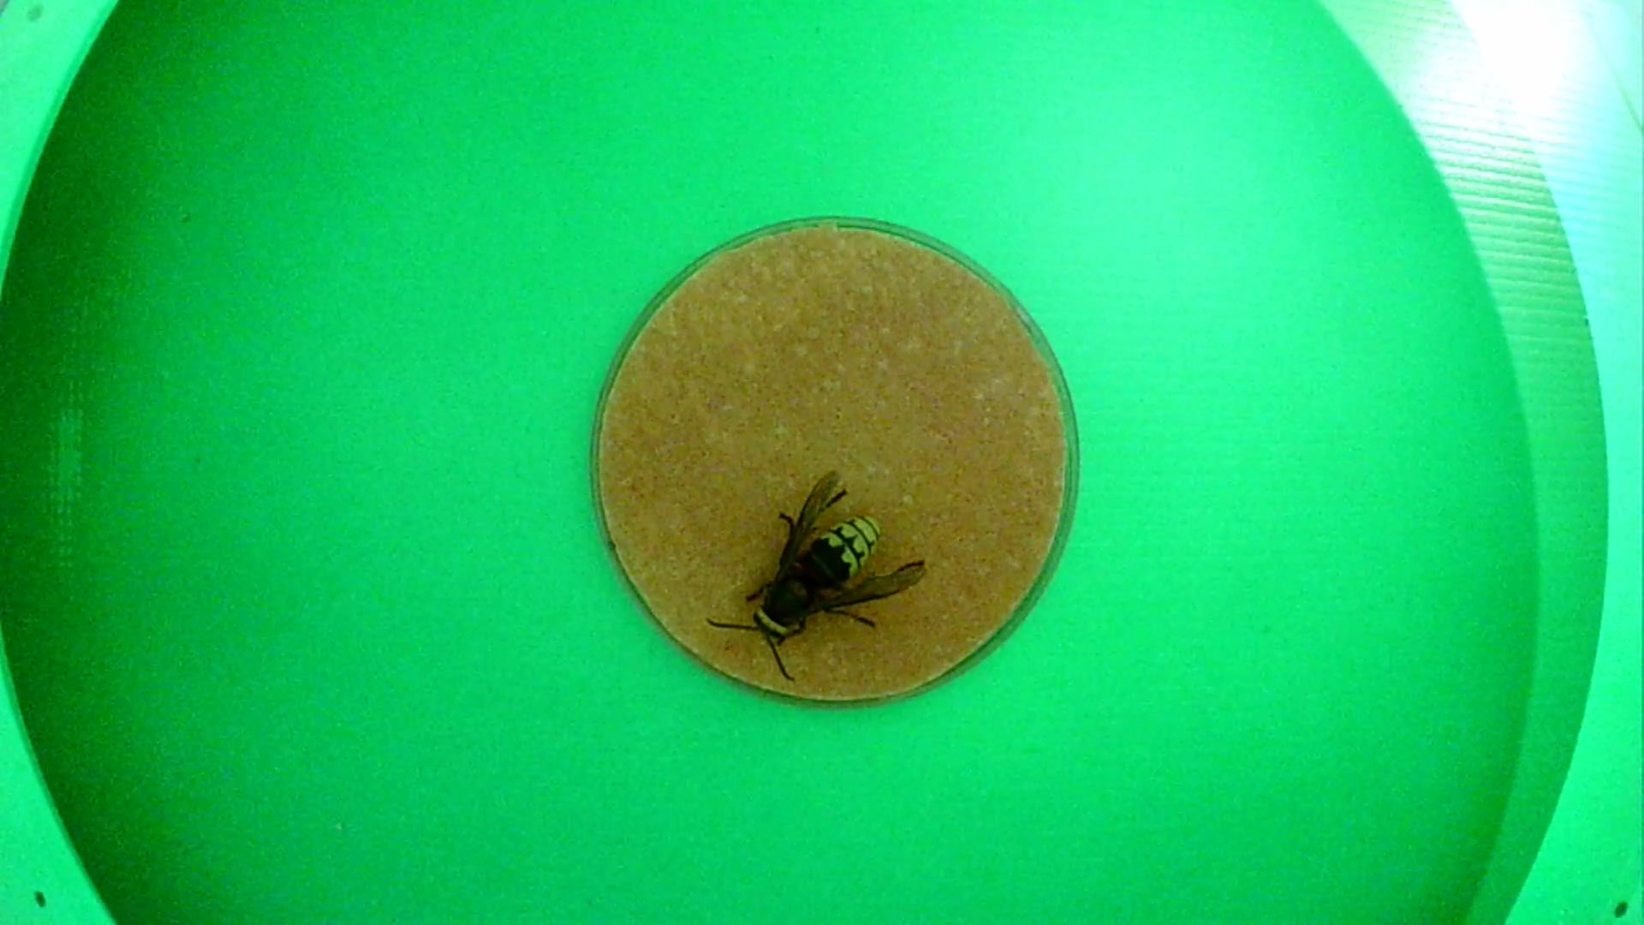
Hornet Dataset
Pete’s kitchen hornet
Polygonal labels
Overlapping
Different backgrounds
Timestamps
Other insects

Slide 6
Object detection and classification

Slide 7
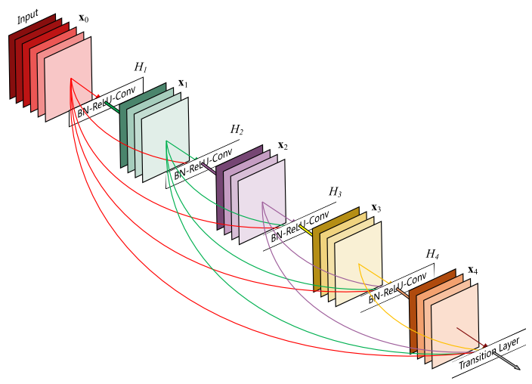
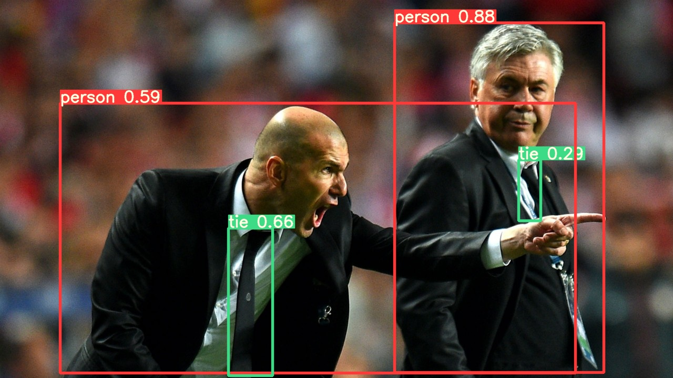
YOLOv5
State of the art object detection
Transfer learning from trained models
Lightweight and heavy architectures

Slide 8
Training a robust network: Image Augmentation

Slide 9
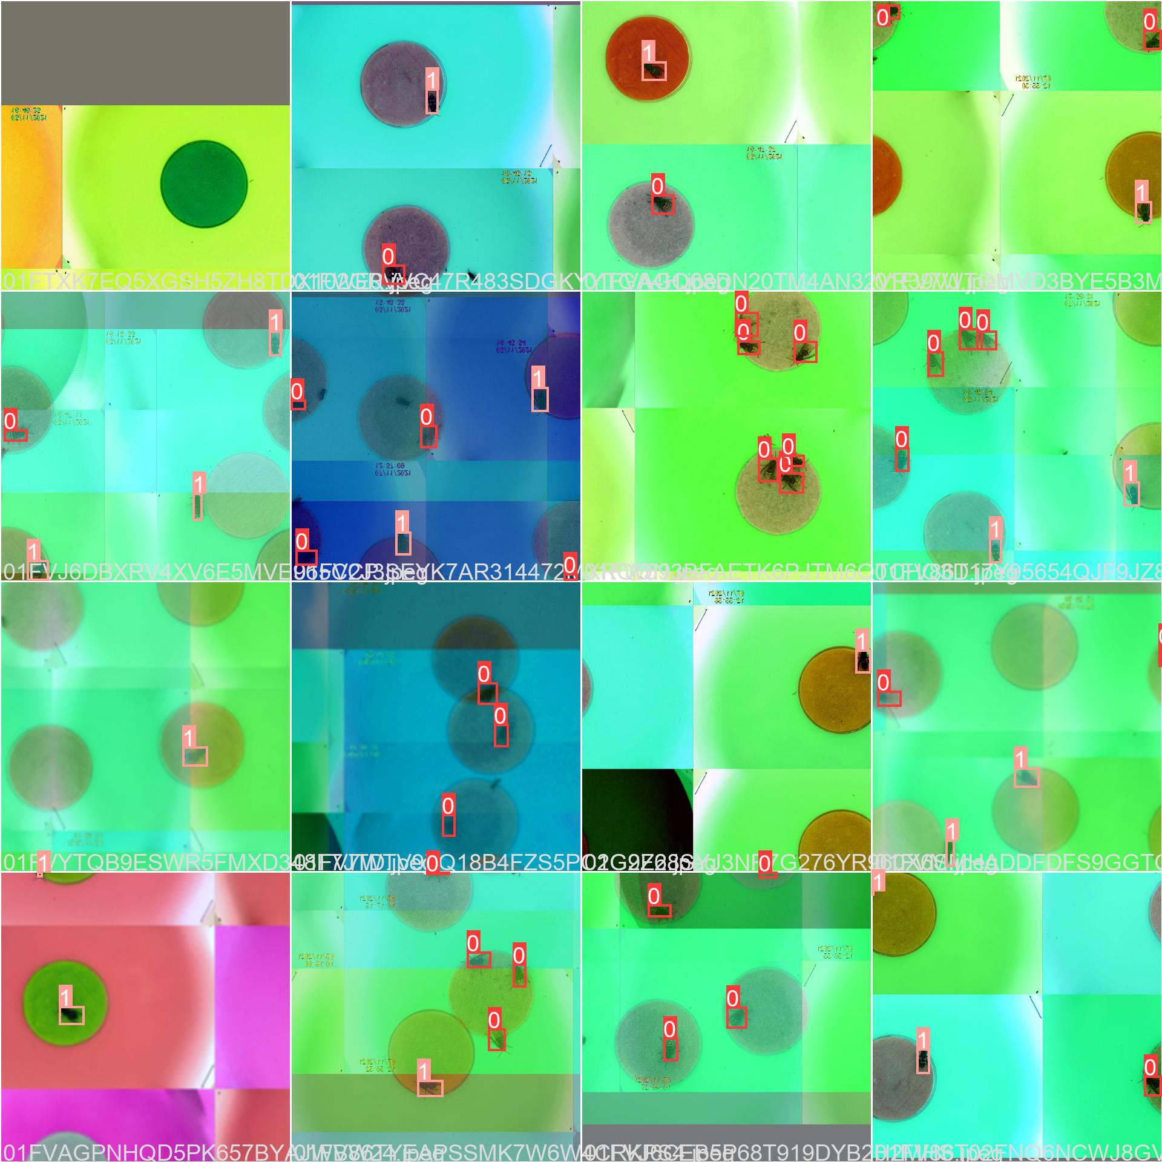
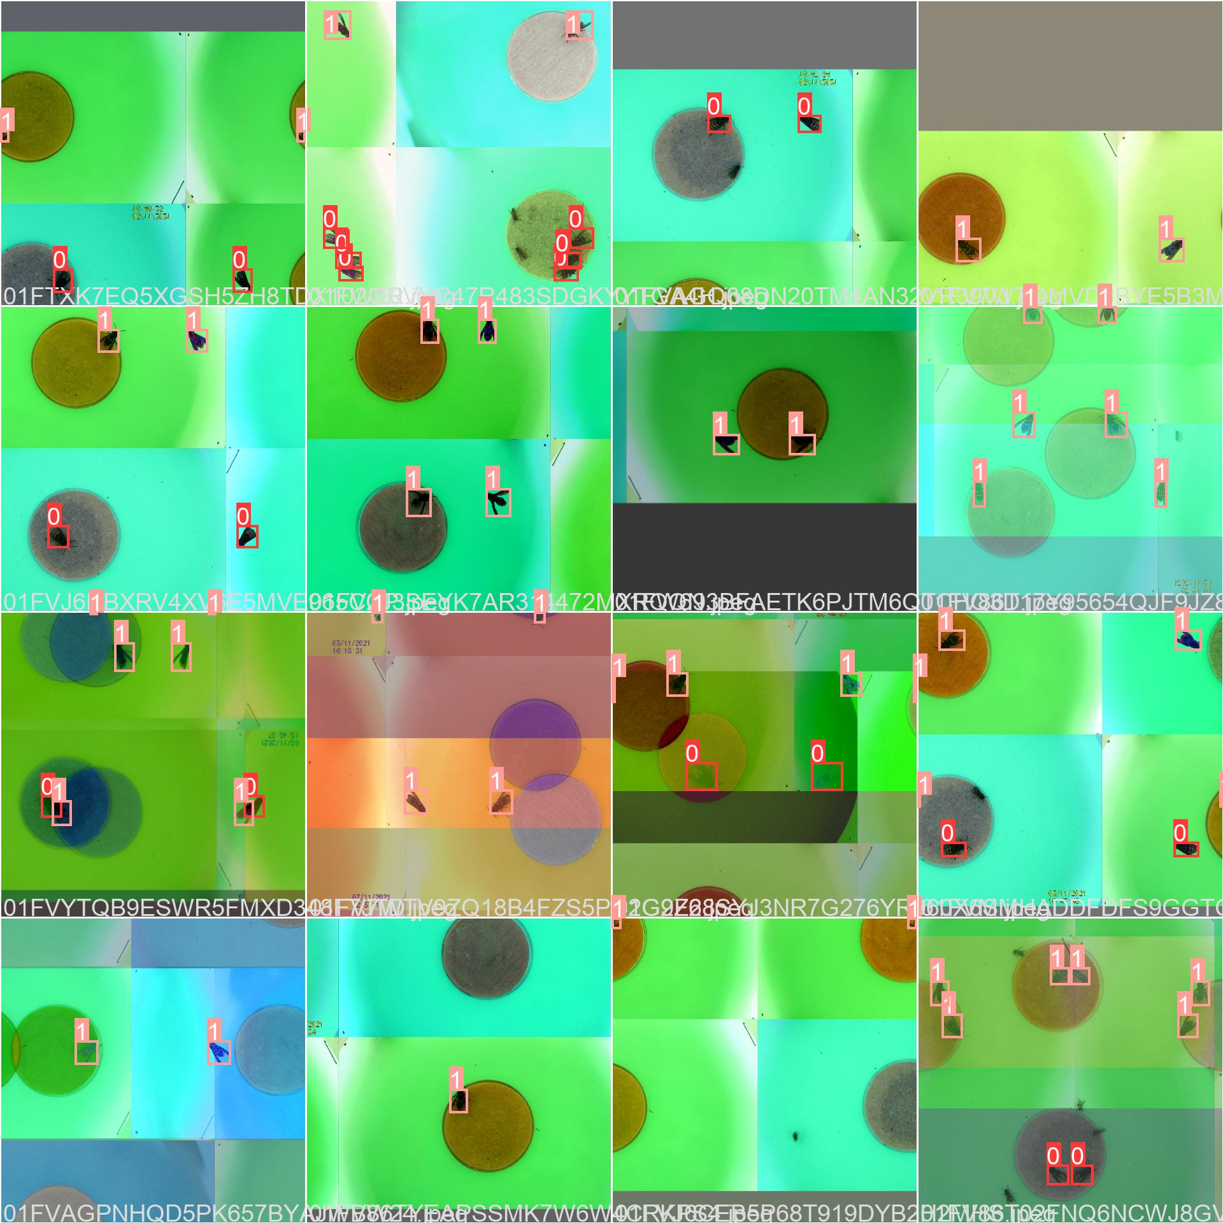
Mosaic tiles
Combine backgrounds onto single image
Randomly crop, shuffle and displace artifacts (e.g. date stamp)

Slide 10
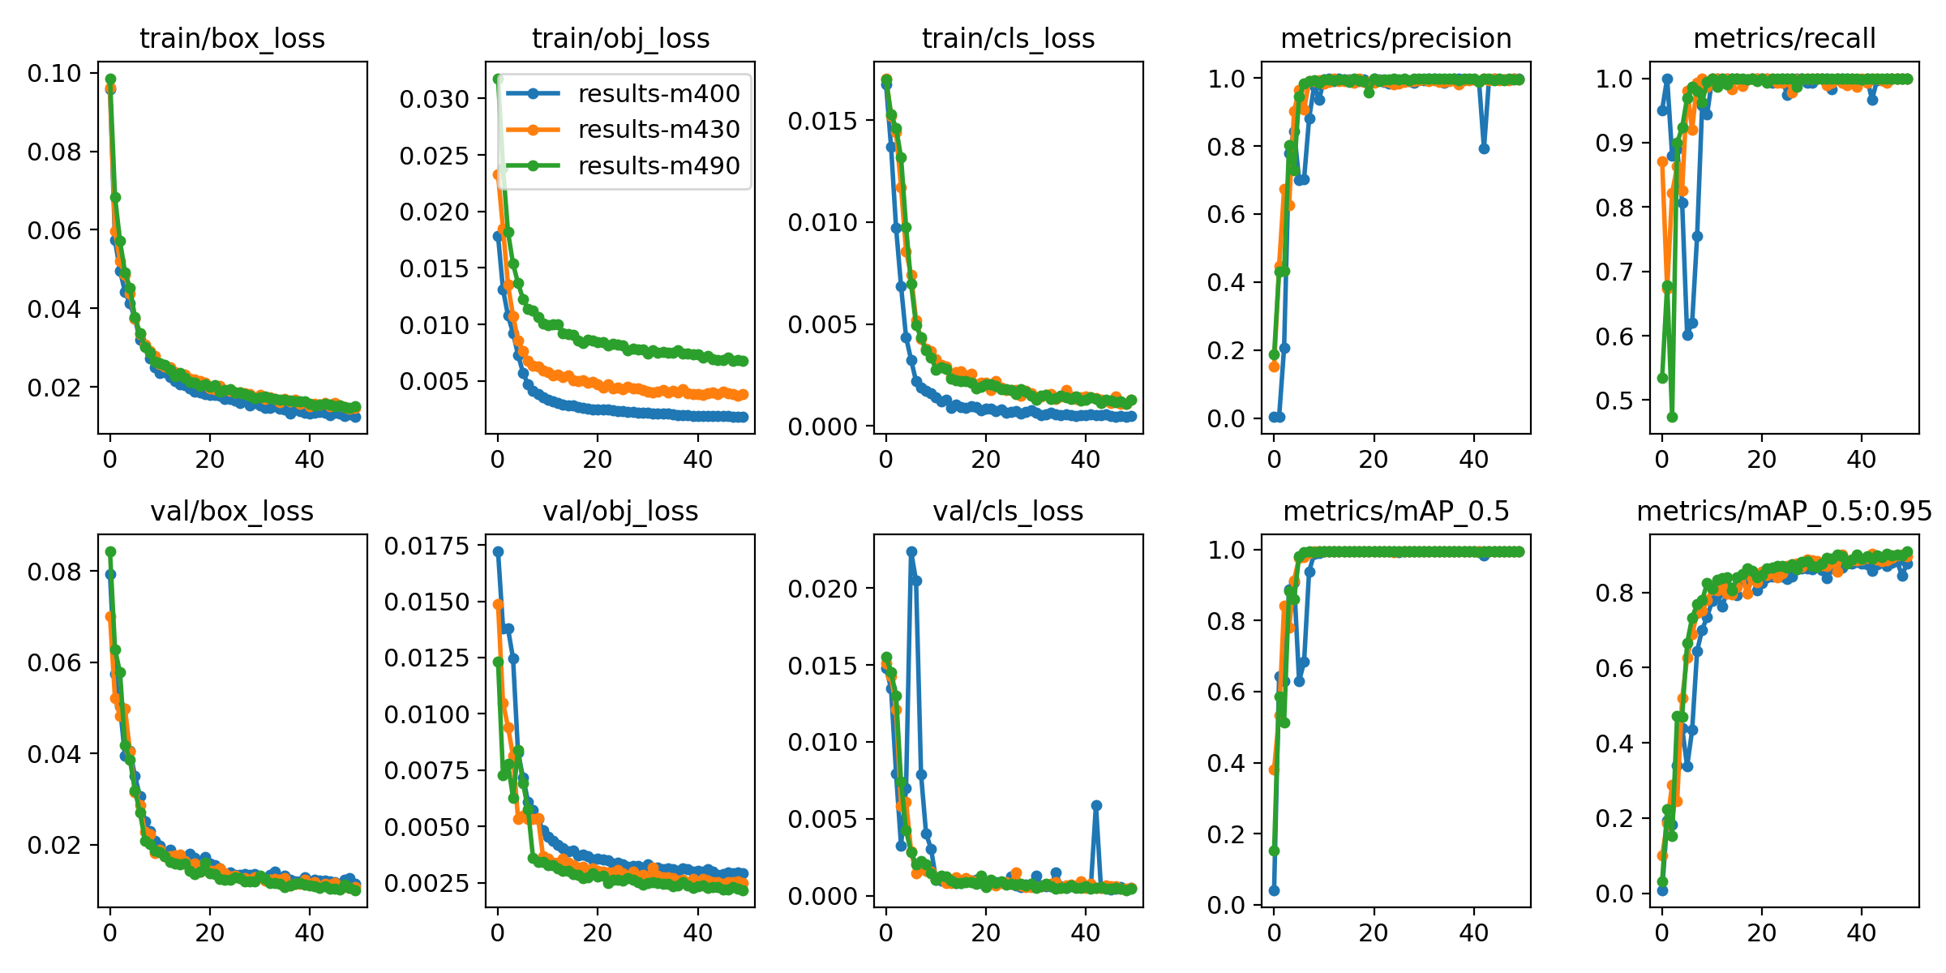
Mosaic tiles
Proportion of training data using mosaics:
0% (best in training)
30%
90% (best in validation)

Slide 11
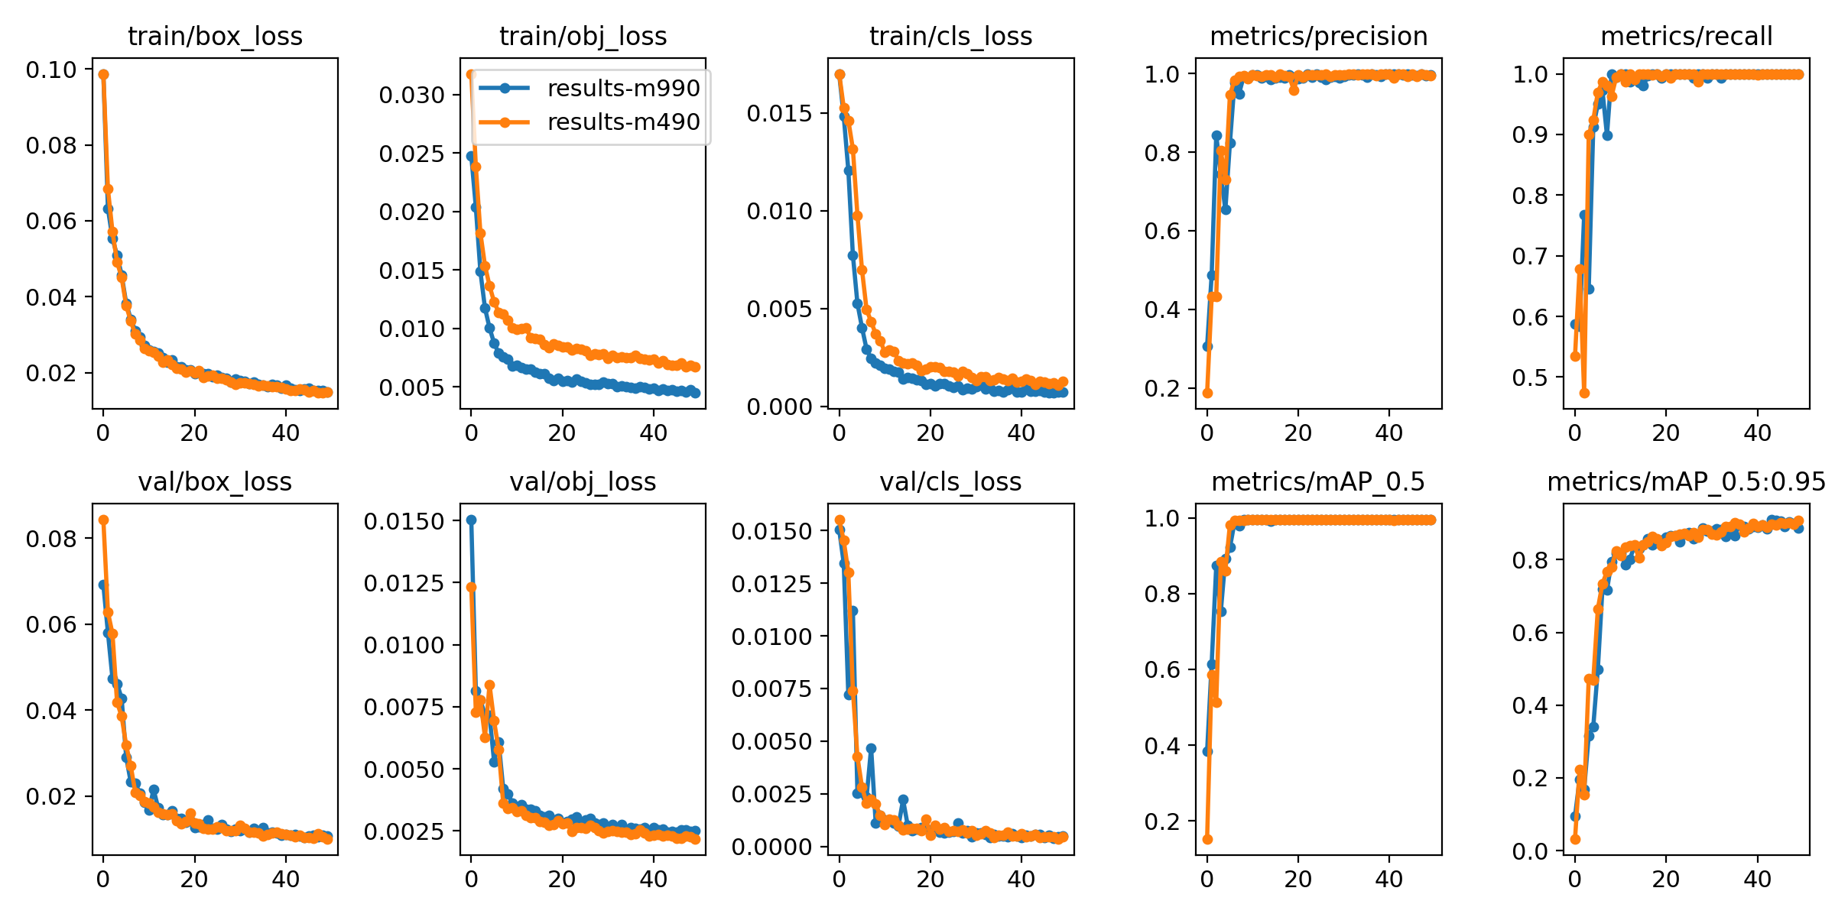
Mosaic tiles
Proportion of training data using mosaics:
9 tiles (best in training)
4 tiles (best in validation)

Slide 12
Augmented colouration
RGB channel swap (30%)
Image blur (20%)
HSV shift (40%)
Brightness/Contrast (50%)
RGB shift* (30%)
To account for variation in camera and environment set-up.
*Small deviations in each RGB channel to account for partially bleached backboards.

Slide 13
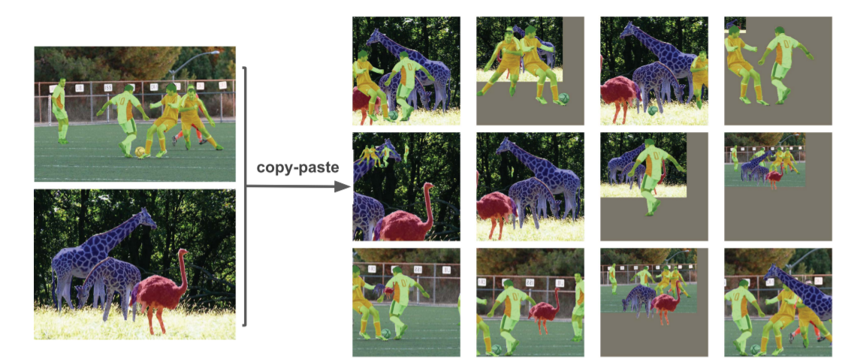
Copy-paste augmentation
Utilise polygon labelling (thanks Pete & Thomas!)
Put hornets onto different backgrounds during training

Slide 14
Copy-paste augmentation
Same hornets, different bait station.
Utilise polygon labelling (thanks Pete & Thomas!)
Put hornets onto different backgrounds during training
Robust to time-stamped images

Slide 15
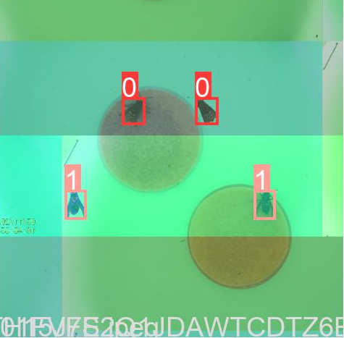
Mix-up augmentation
Overlay images proportionally
Place different hornets on different backgrounds
Generate realistic background augmentations

Slide 16
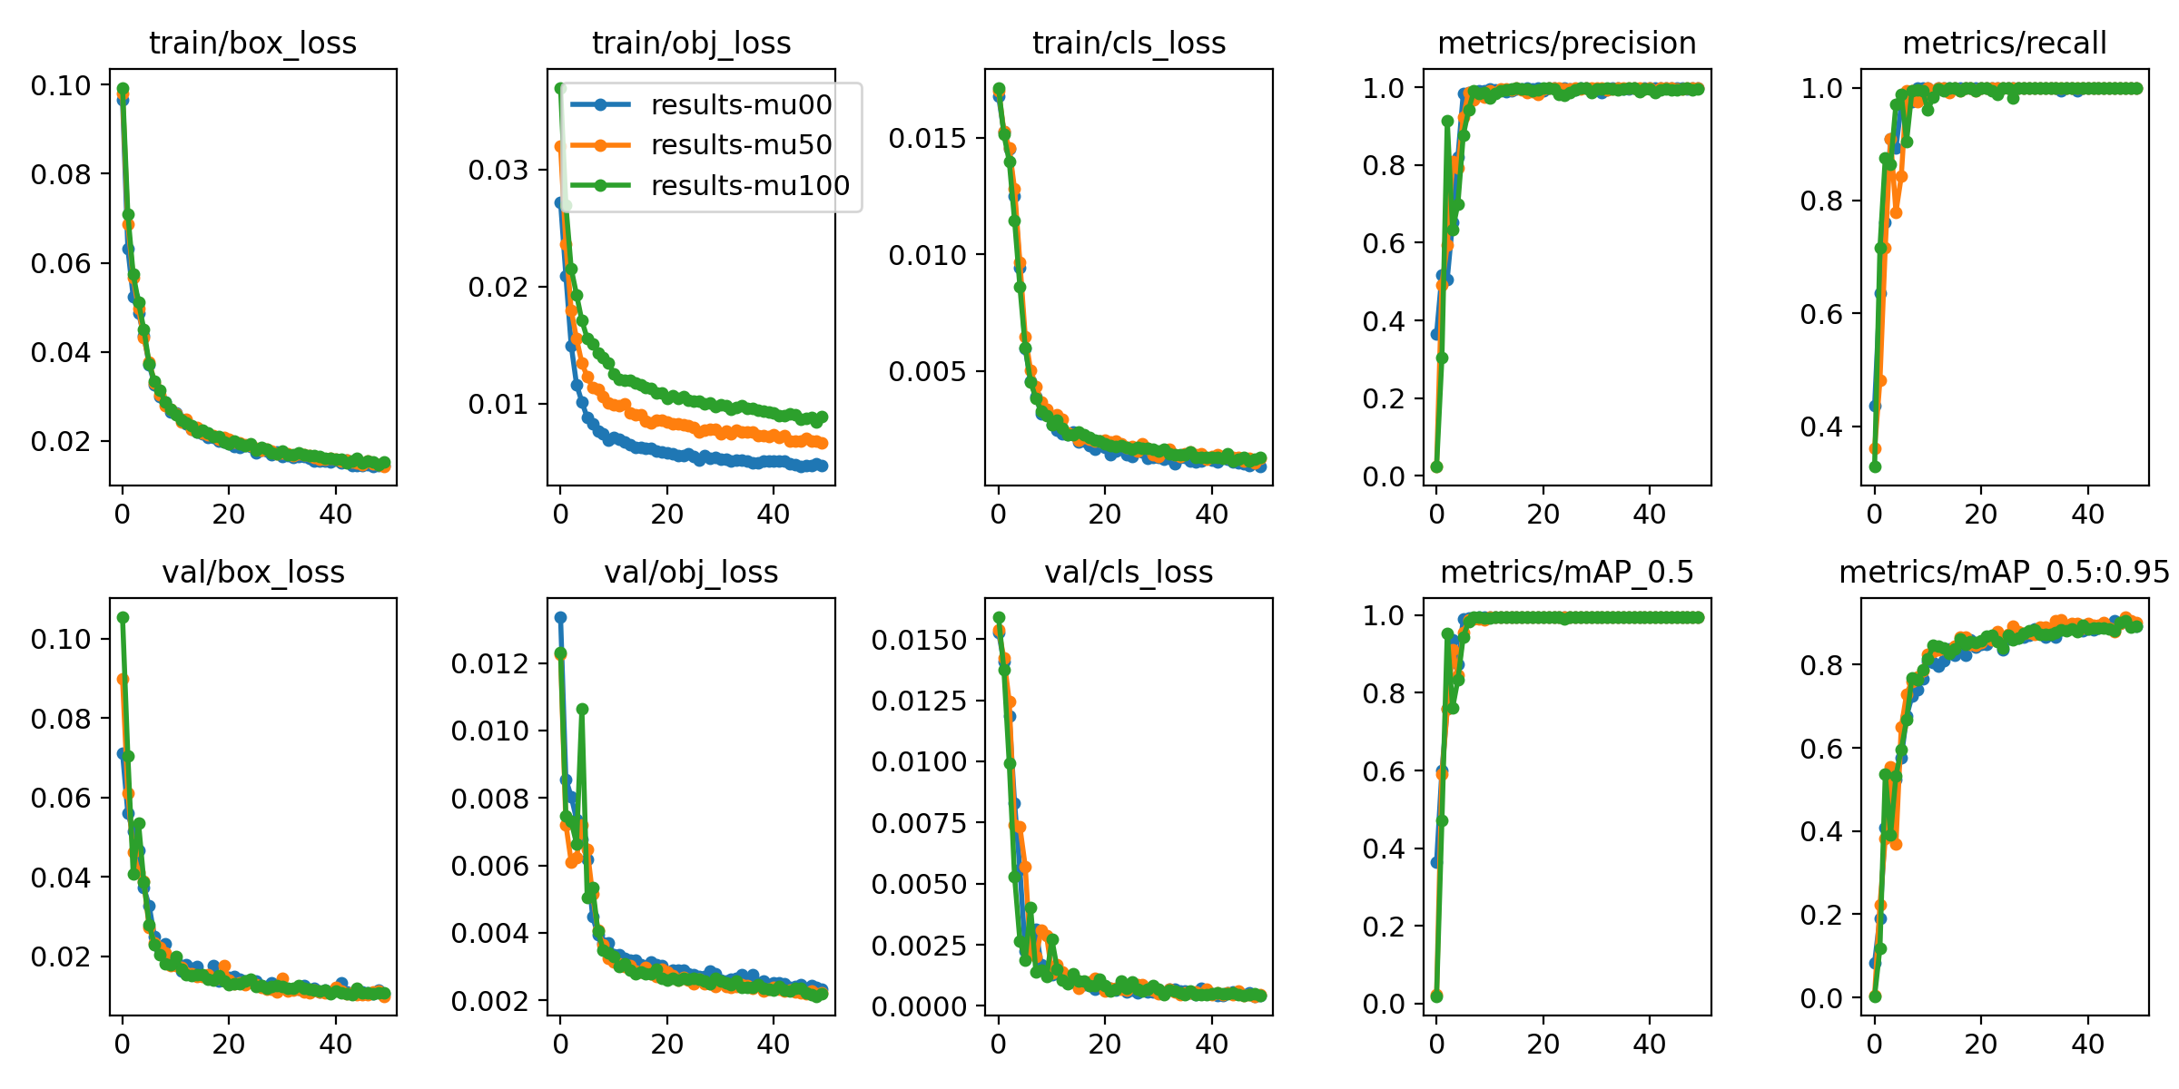
Mix-up augmentation
Proportion of training data using mix-up:
0% (best in training)
50% (well performing)
100% (well performing)

Slide 17
Output: detections with confidence

Slide 18
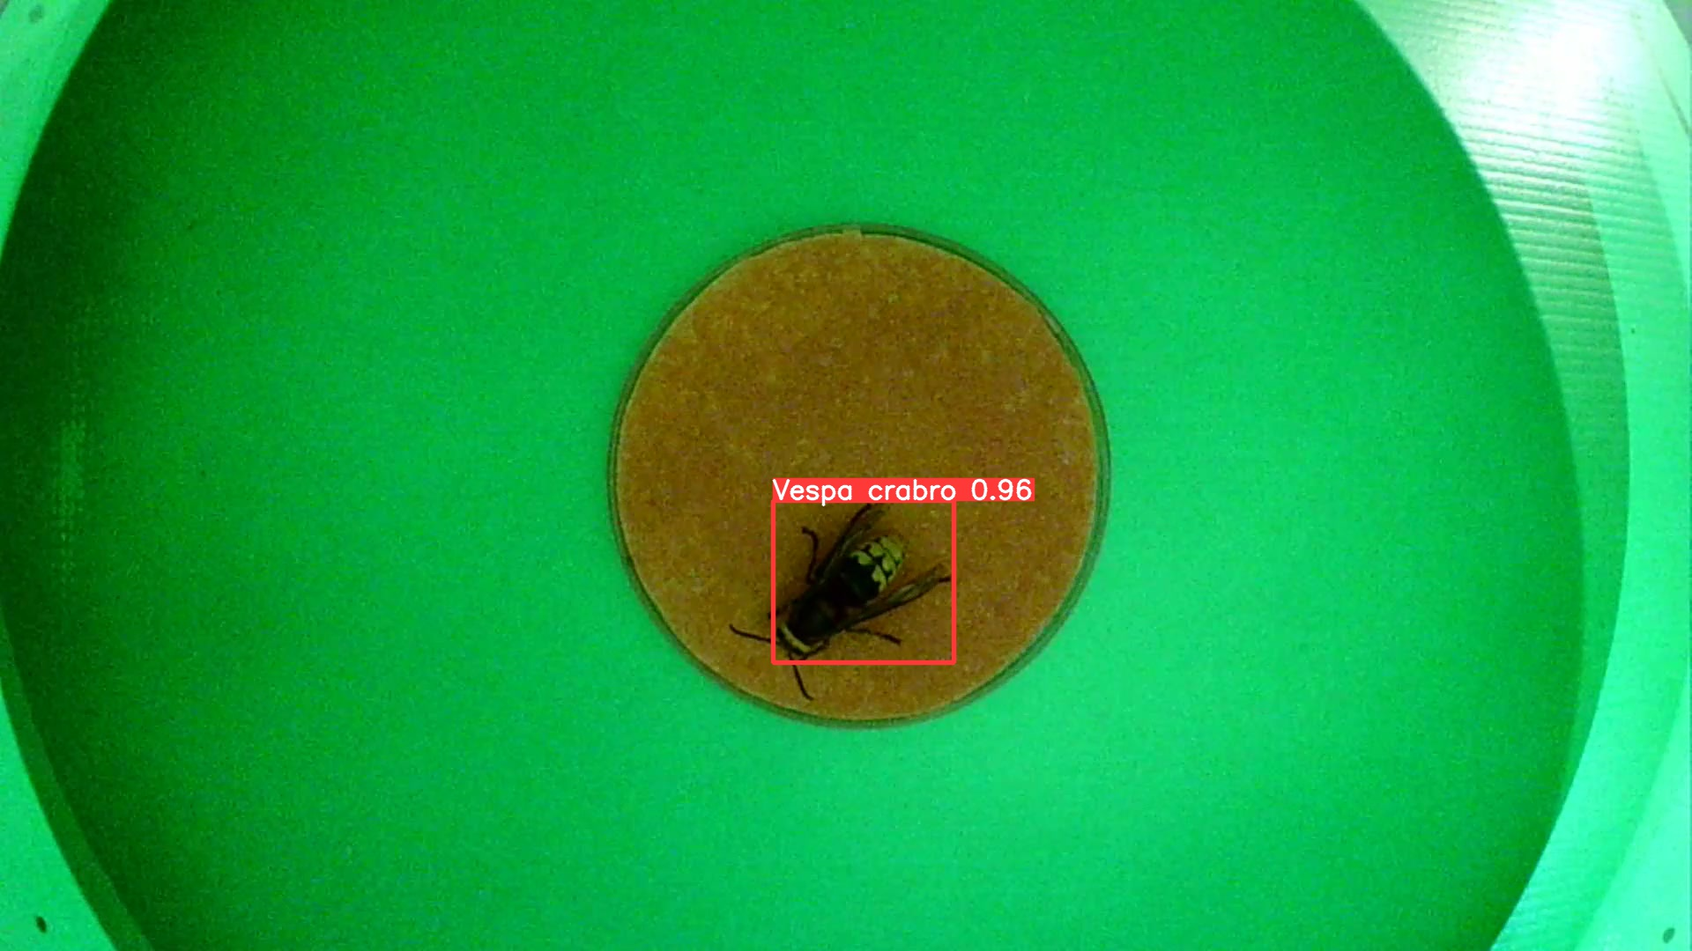
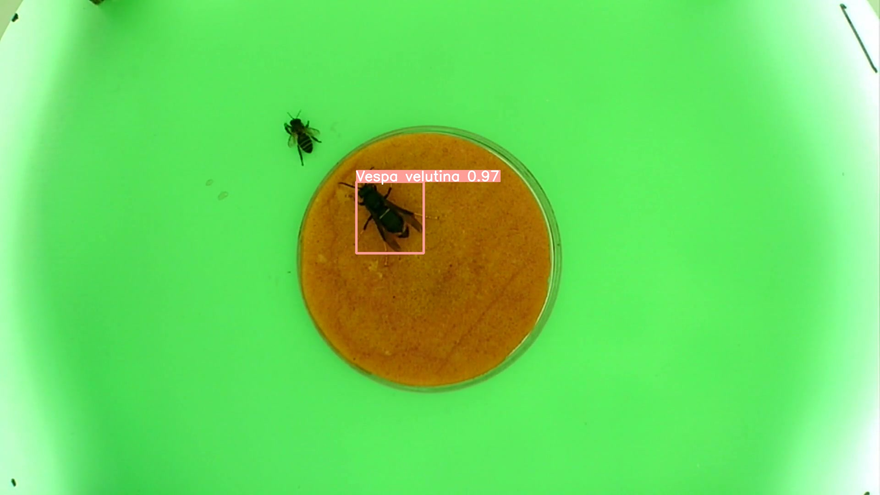
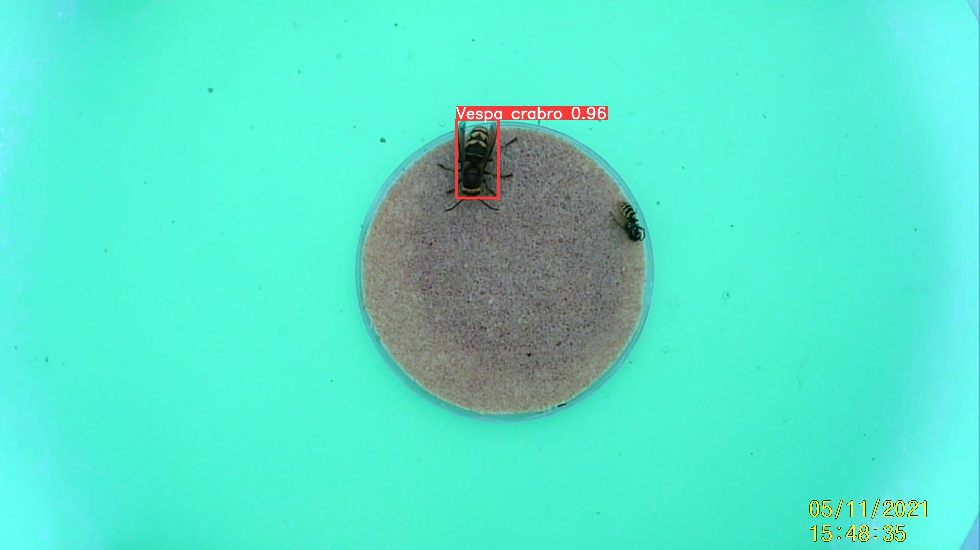
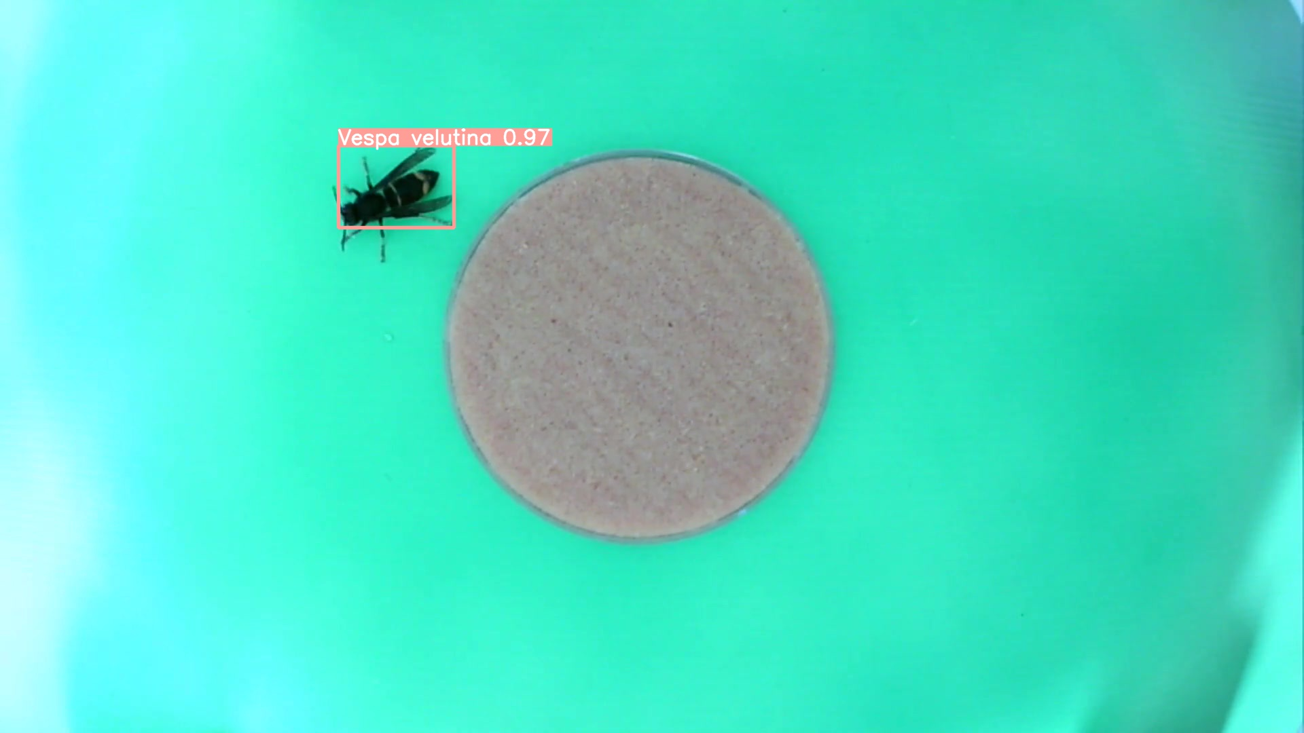
Model outputs candidate detections to be sent to bait station attendant.

Slide 19
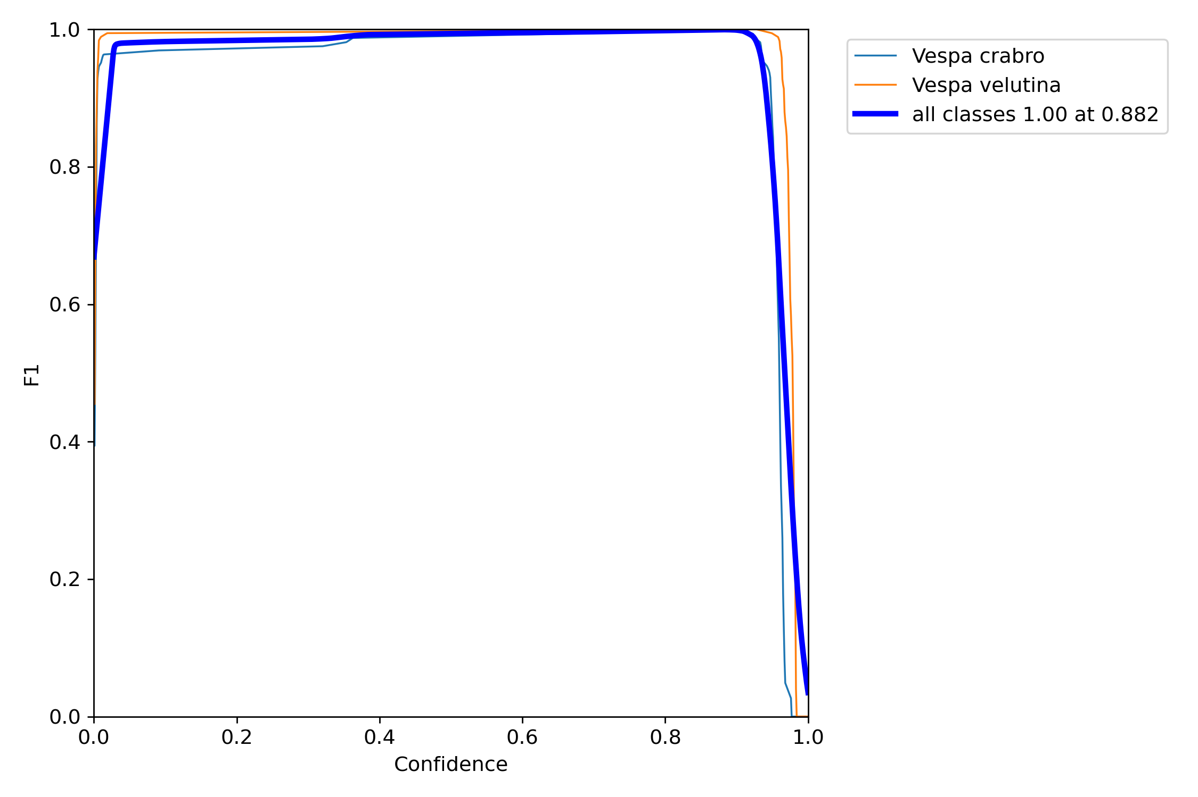
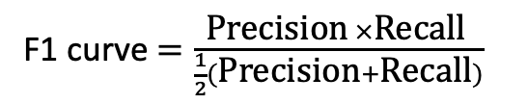
Still overfitting?
F1 curve $=\frac{\text{Precision} ×\text{Recall} }{\frac{1}{2}(\text{Precision}+\text{Recall})}$

Slide 20
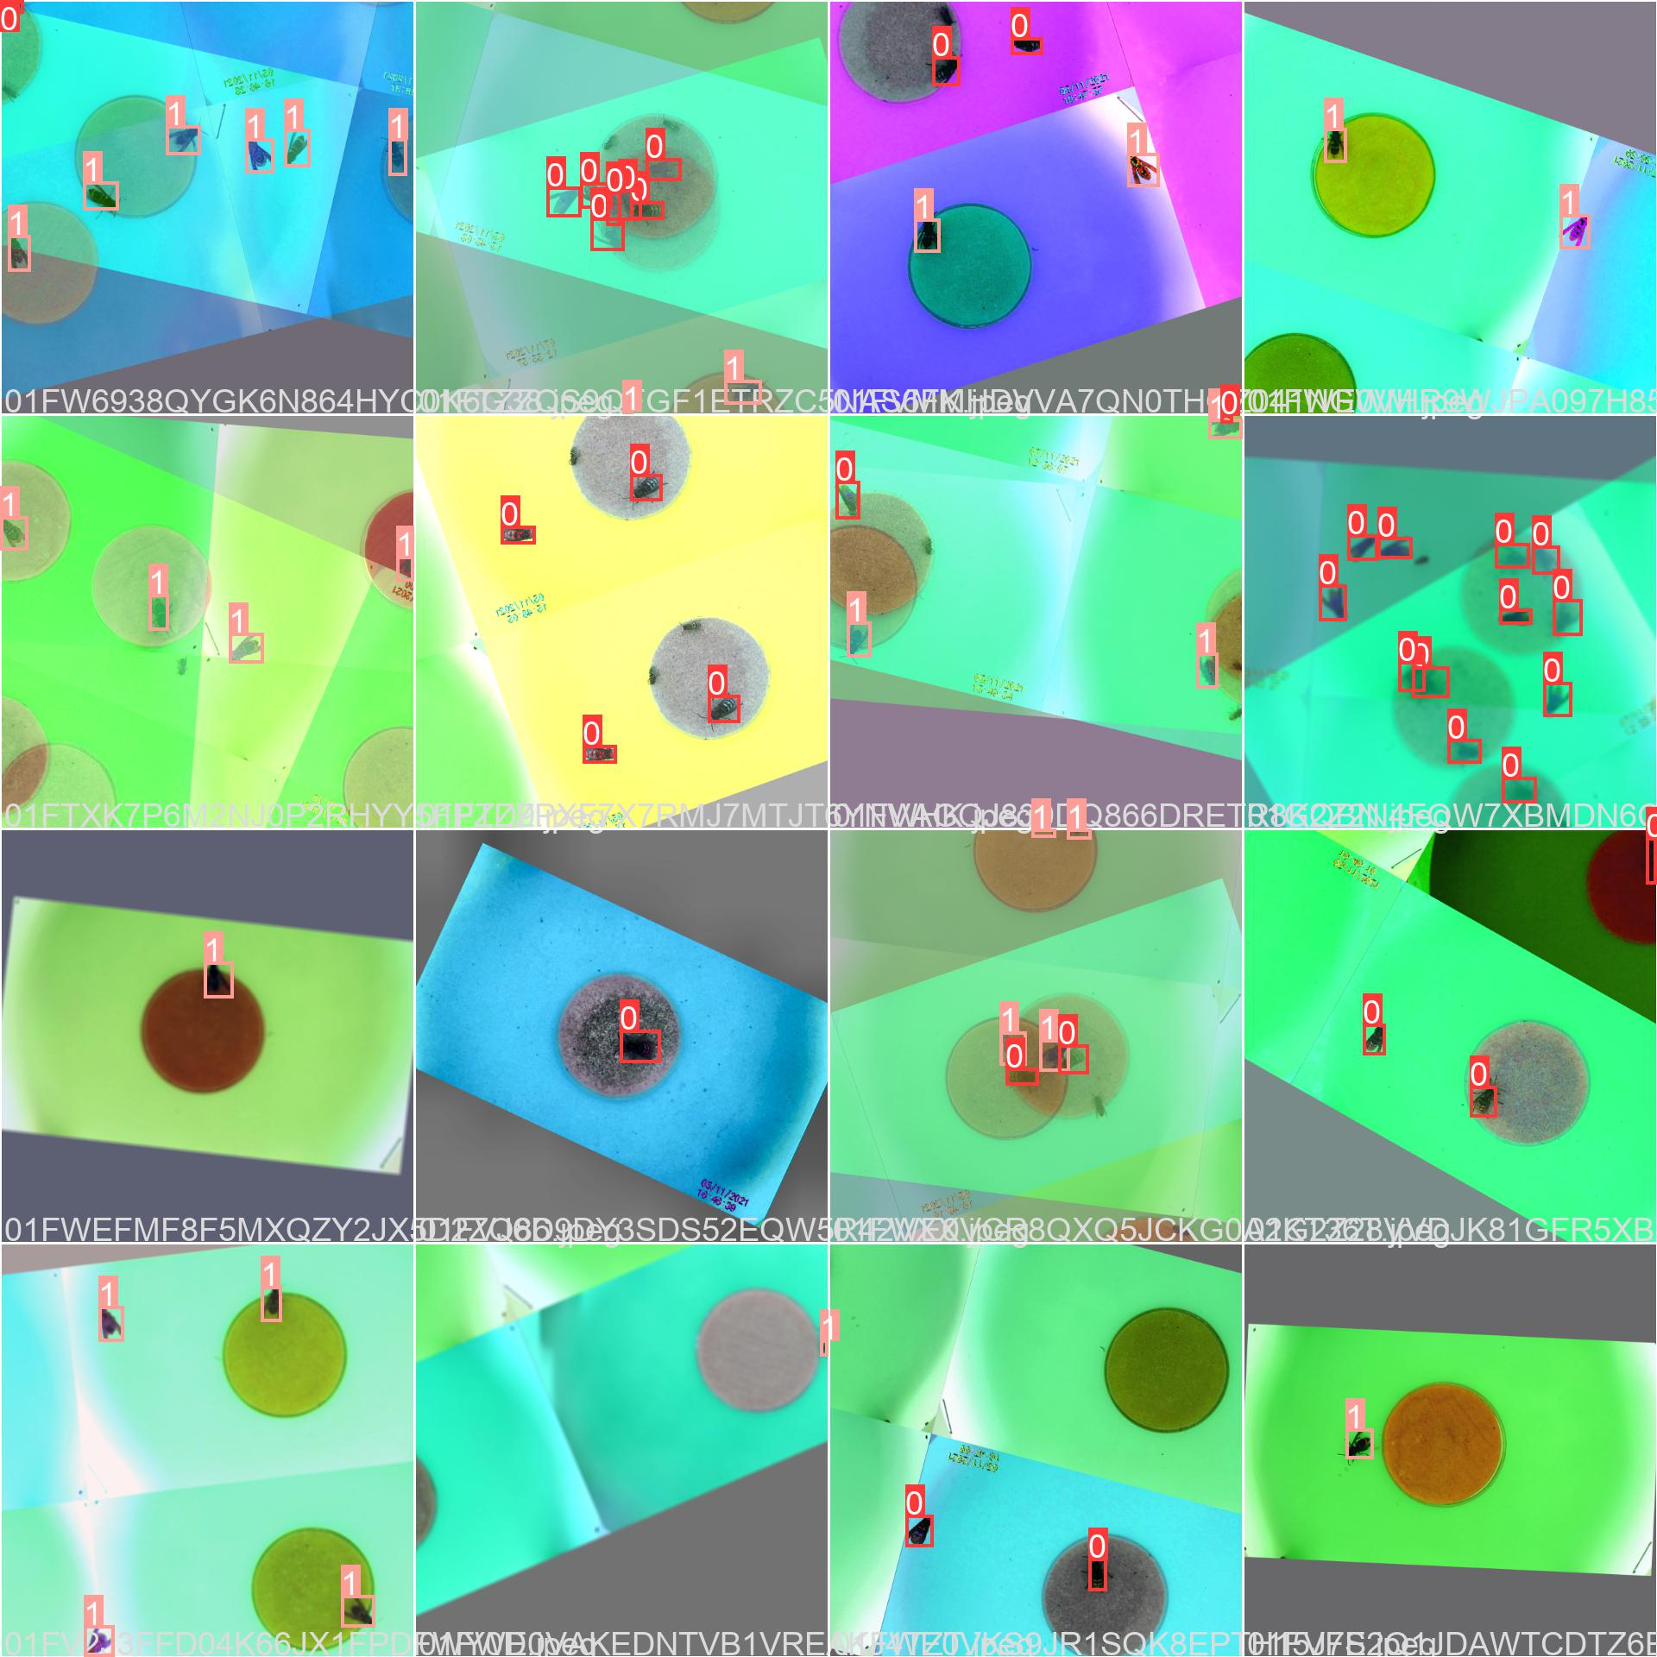
Moment of madness

Slide 21
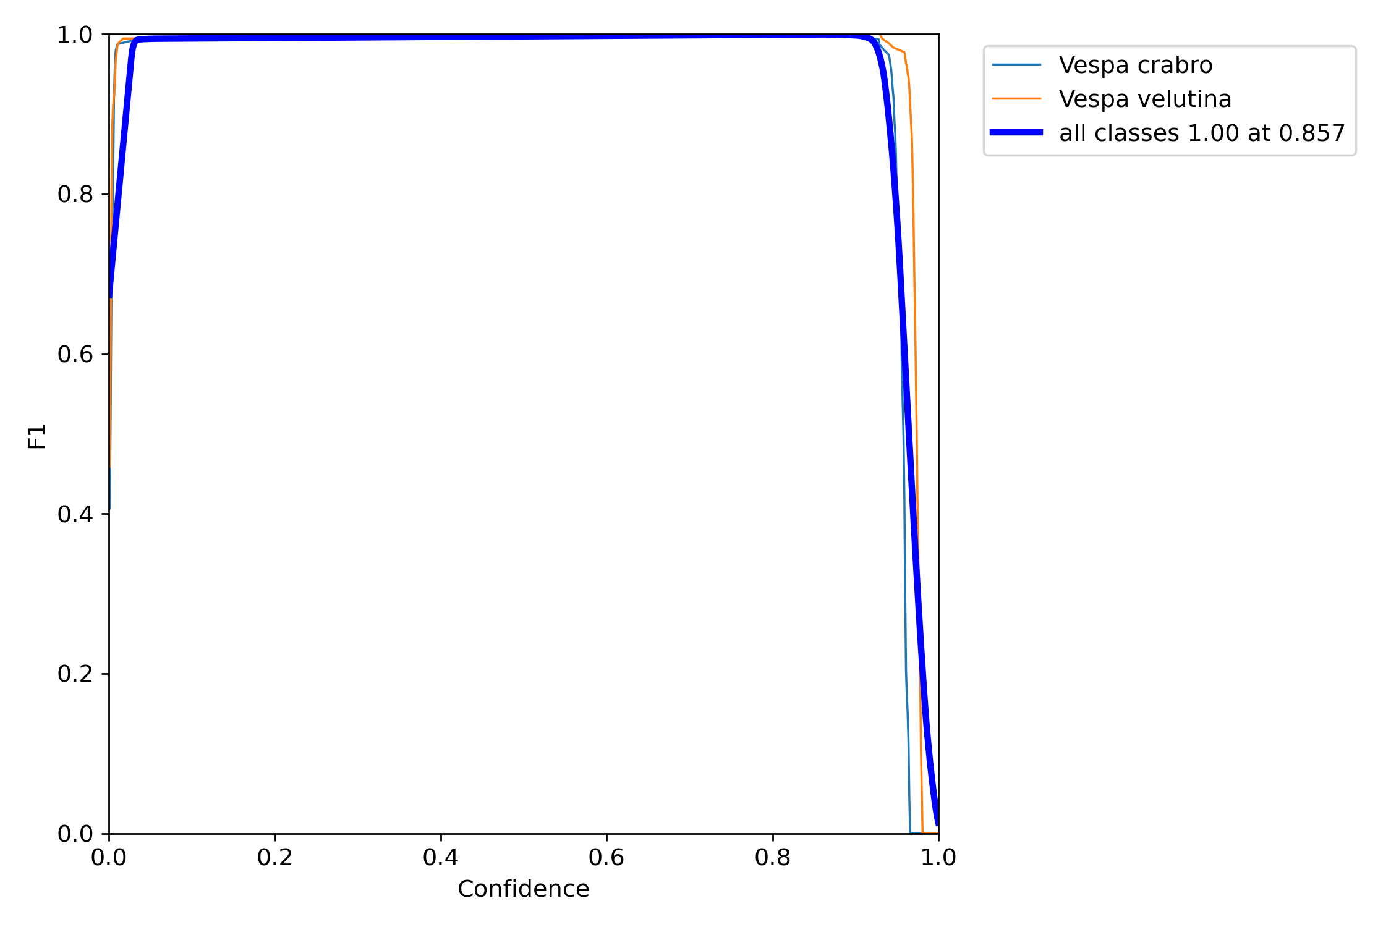
Rotation augmentation results
vs. 0.882 without rotations

Slide 22
Explaining the machine’s thinking

Slide 23
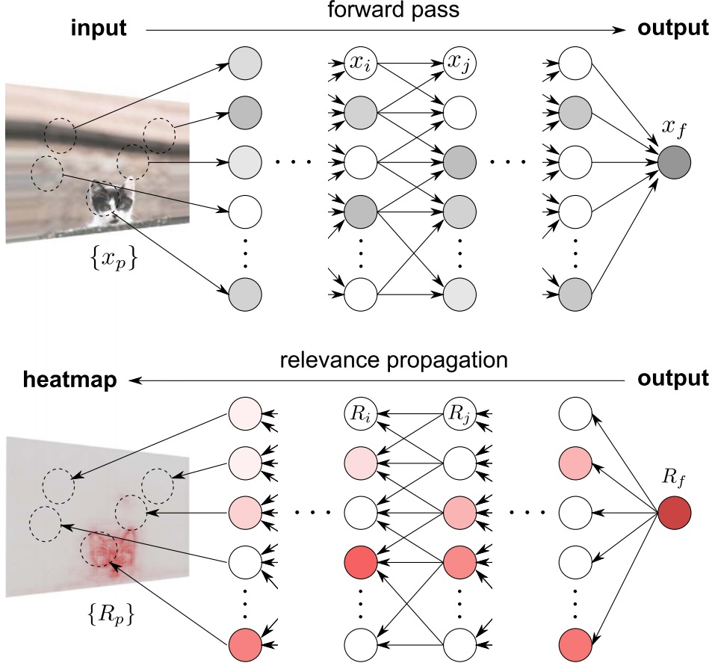
Layer-wise Relevance Propagation (LRP)

Slide 25
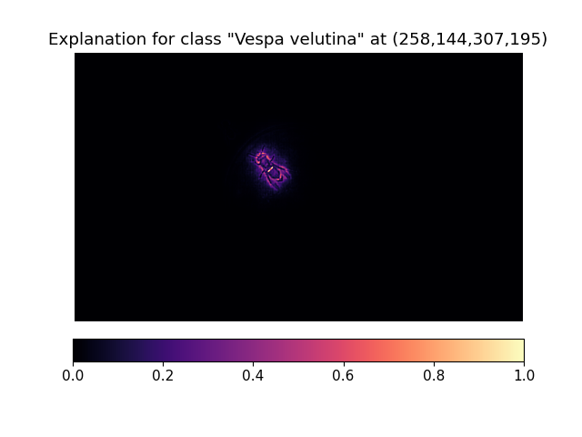

Slide 26
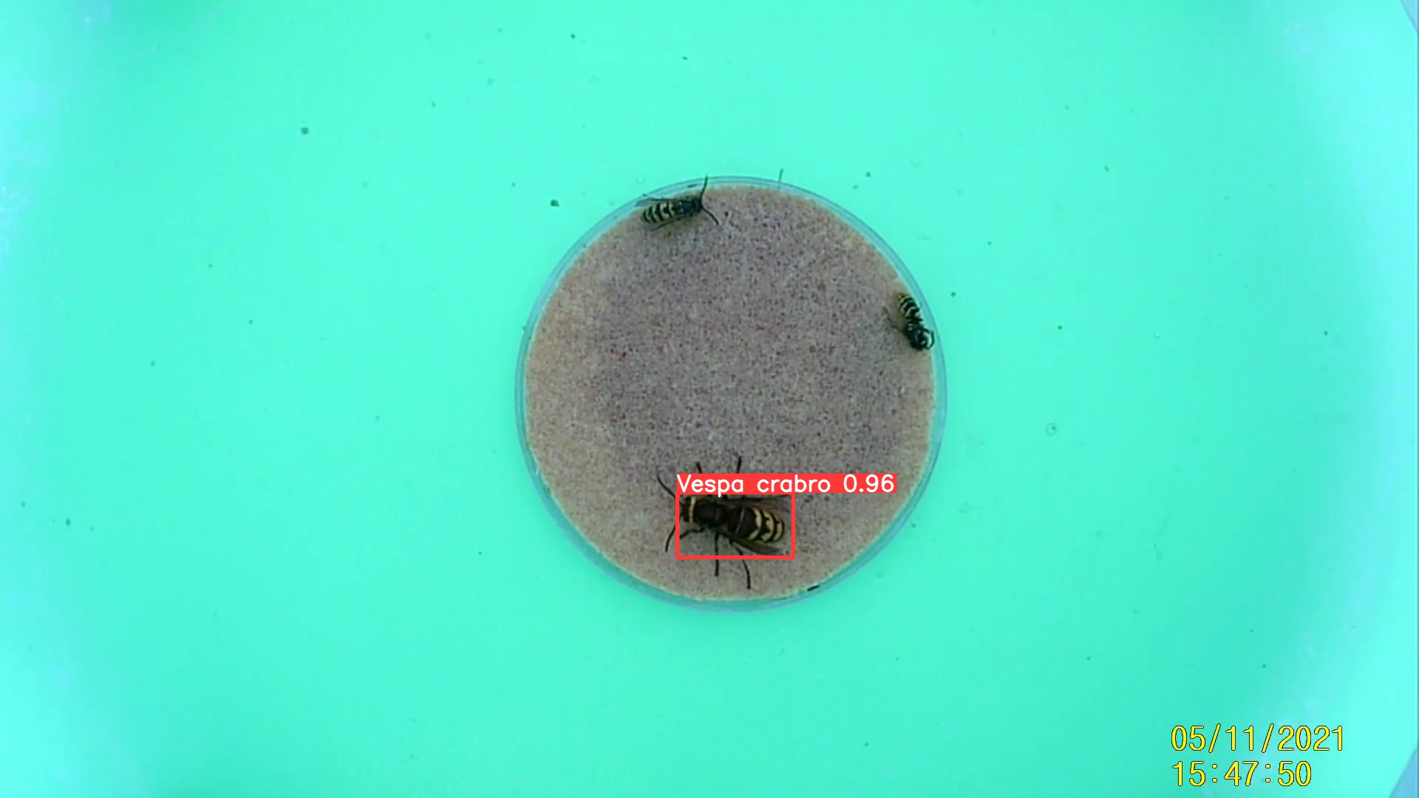

Slide 27
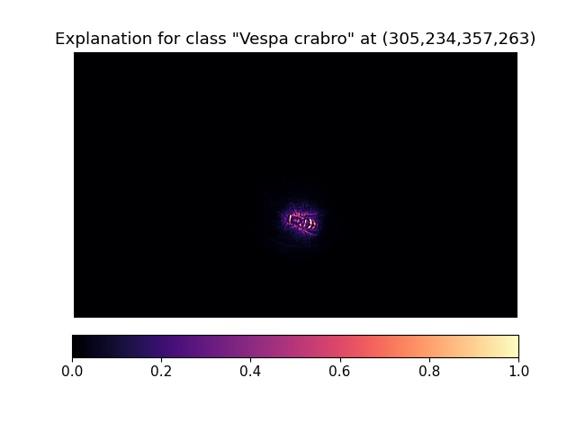

Slide 28
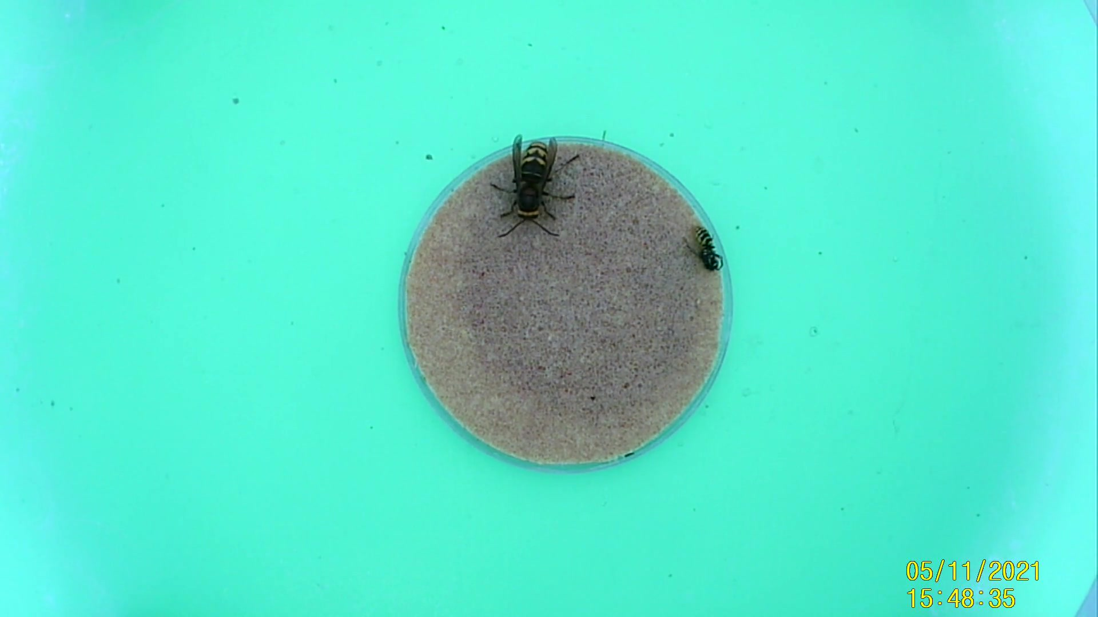
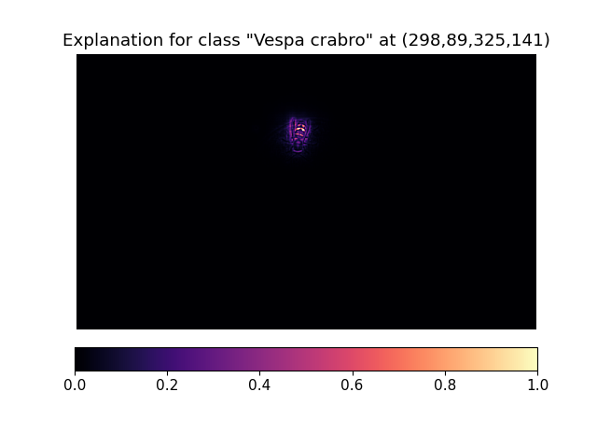
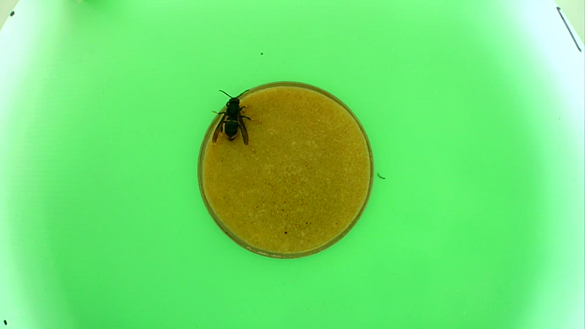
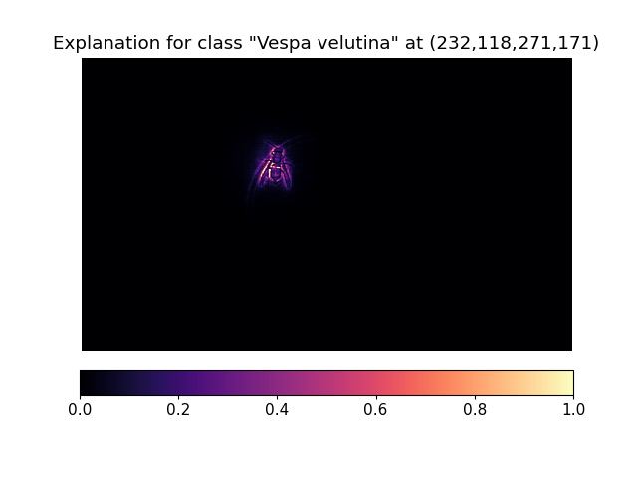
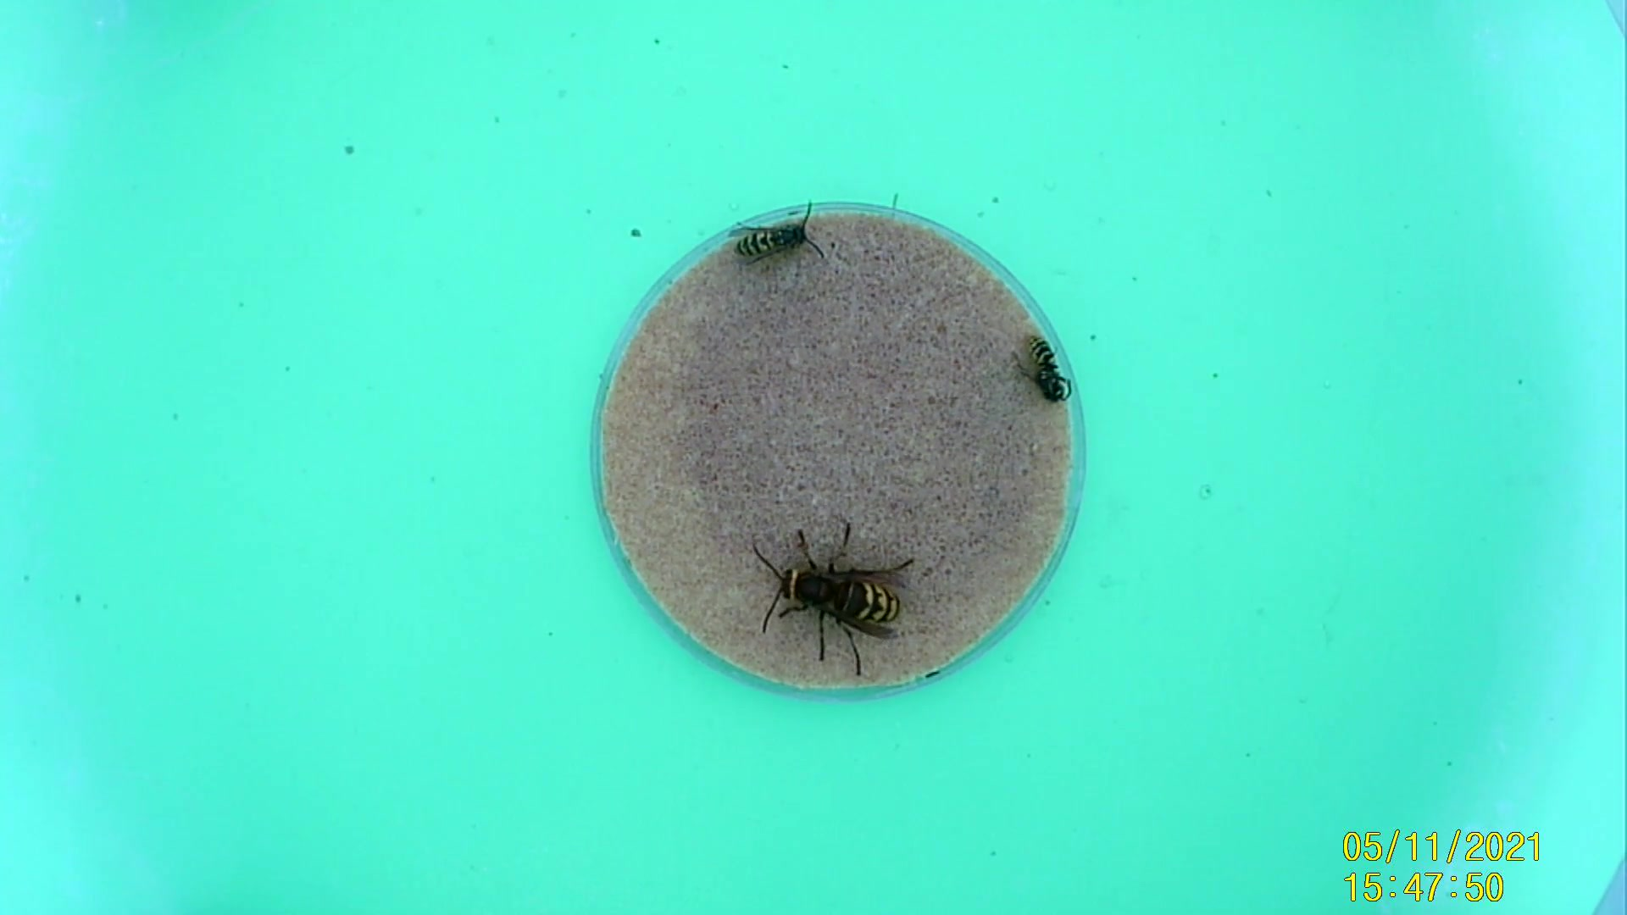


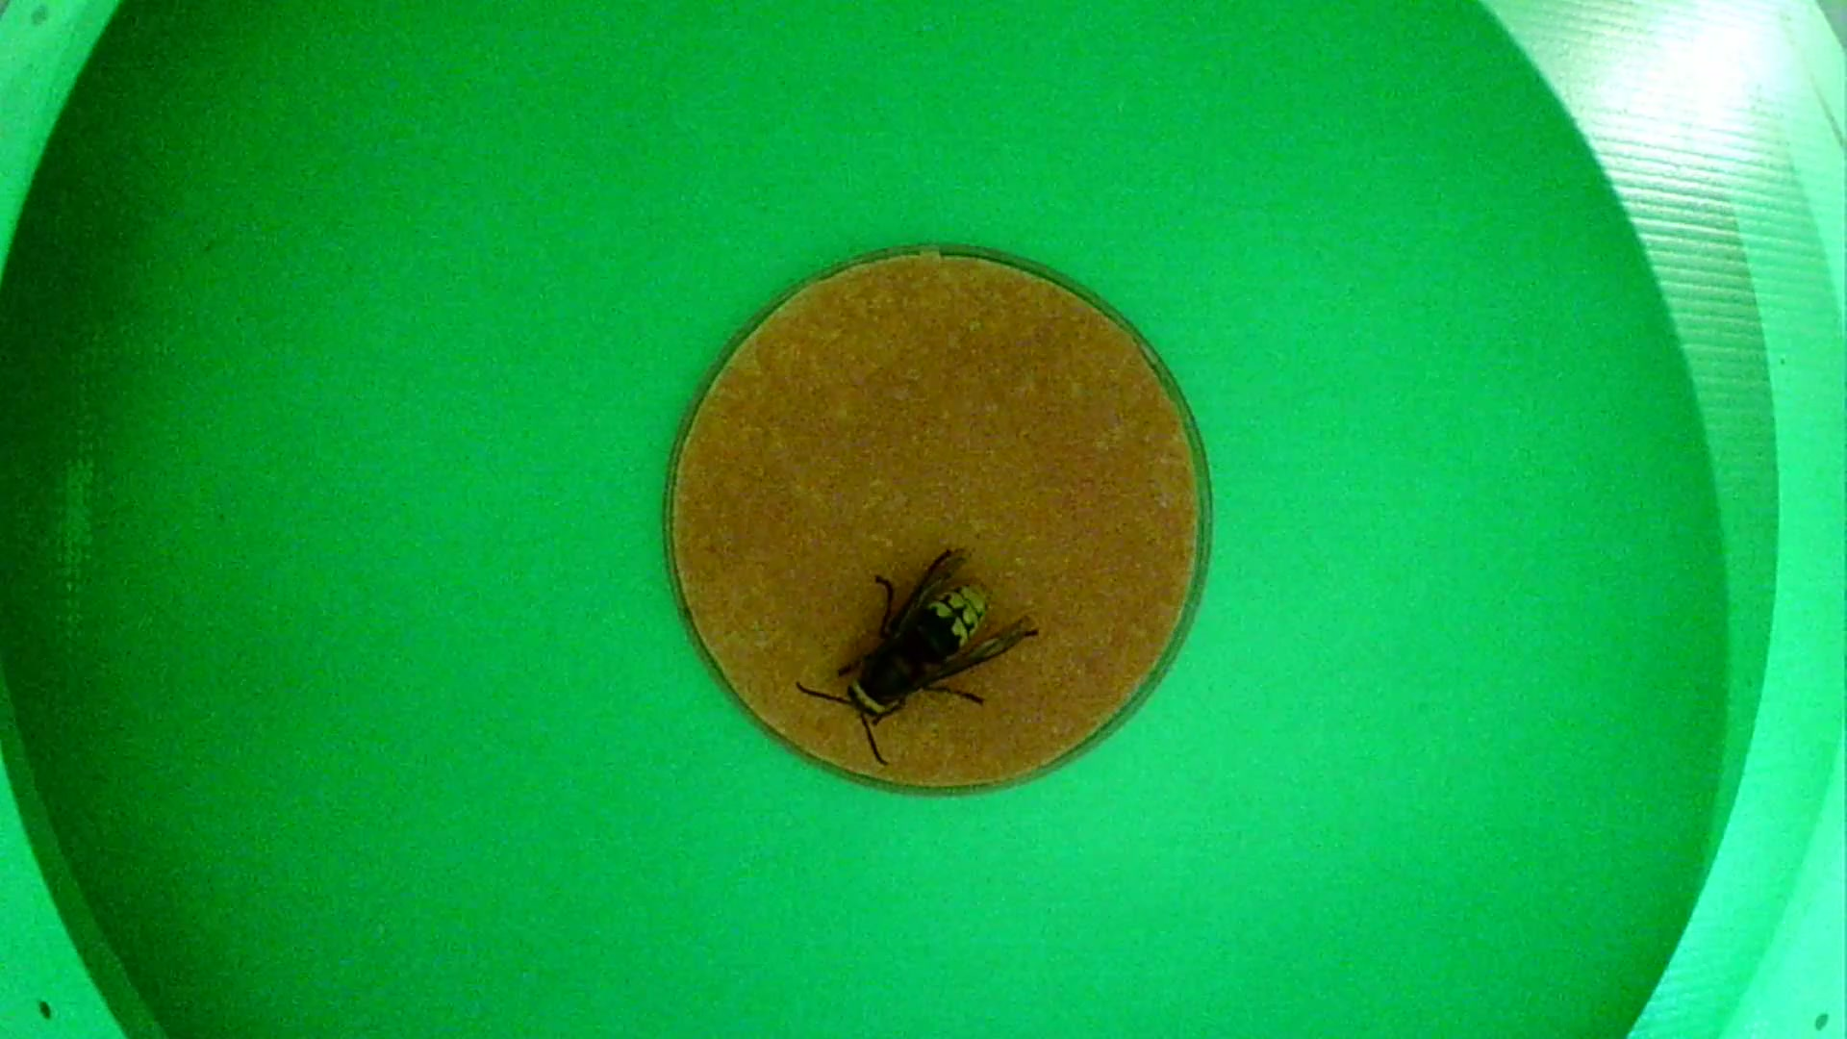

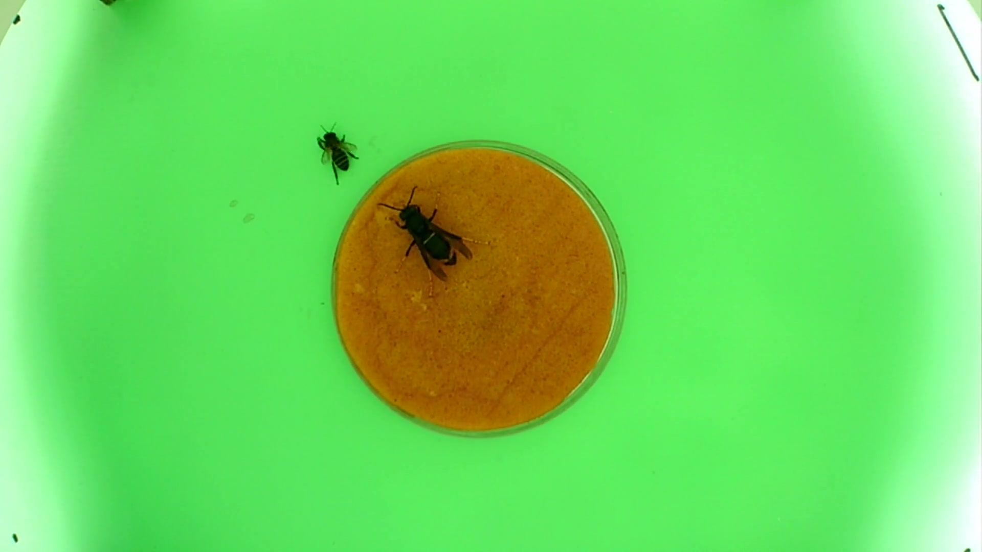
Vespa crabro
Vespa velutina

Slide 29
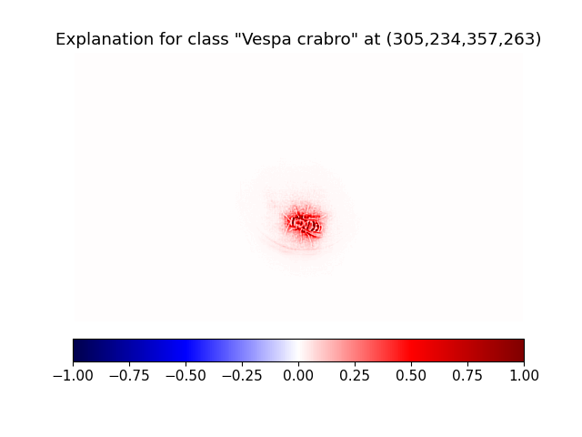
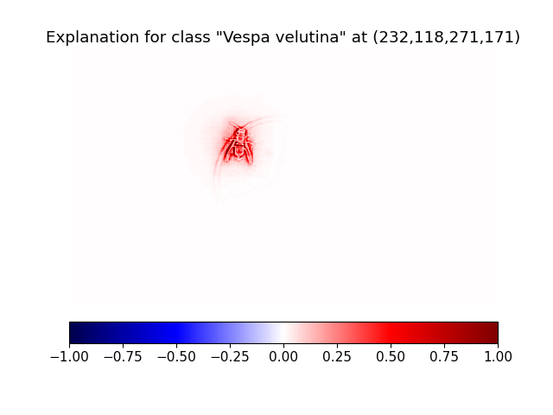
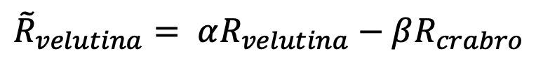
Contrastive LRP
Relevance computed by subtracting a weighted proportion of other class
Vespa velutina:
$${\tilde{R}}_{velutina}= αR_{velutina}−βR_{crabro}$$

Slide 30
Contrastive LRP
Relevance computed by subtracting a weighted proportion of other class.
Vespa crabro:
$${\tilde{R}}_{velutina}= αR_{velutina}−βR_{crabro}$$

Slide 31

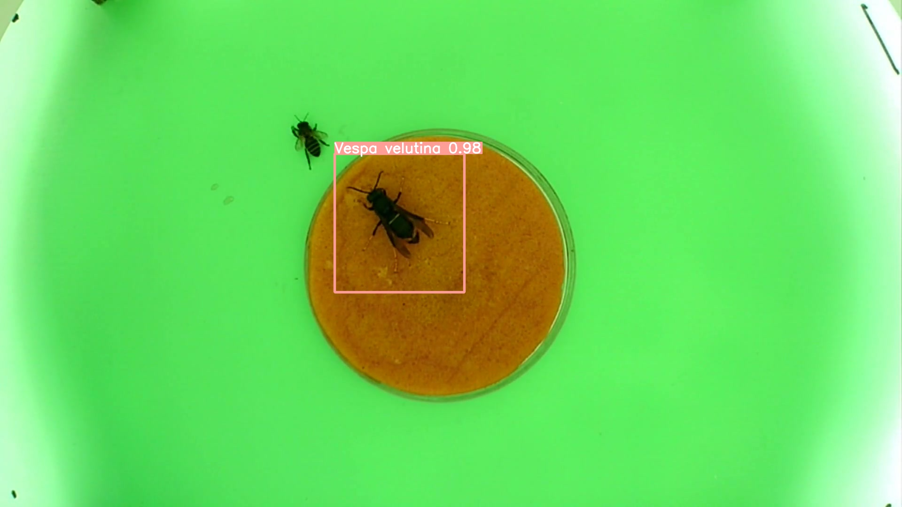

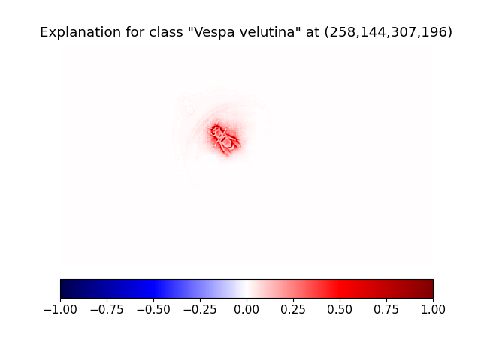

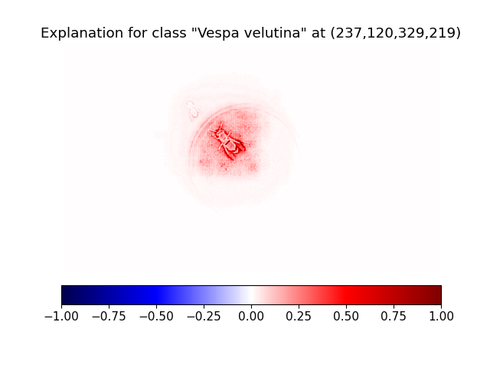
Training against larger box annotations
LRP
Contrastive LRP
LRP
Contrastive LRP

Slide 32
Implementation

Slide 33
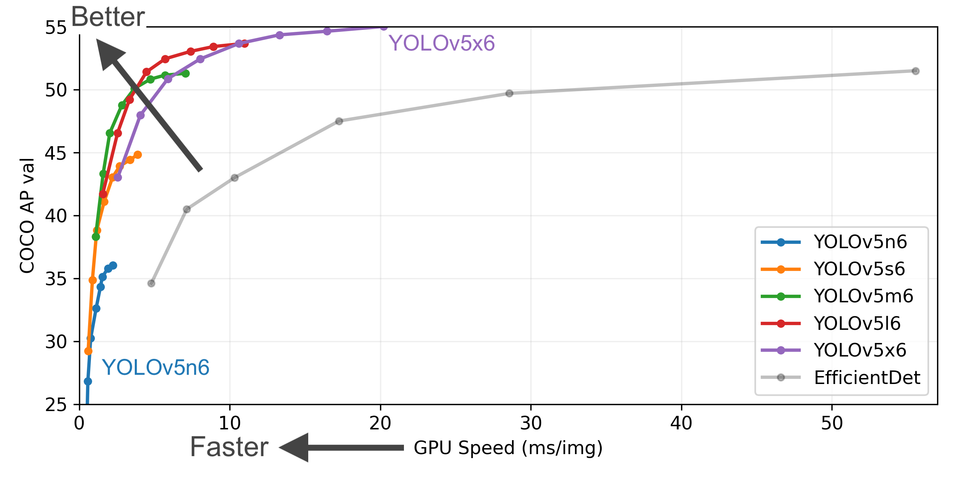
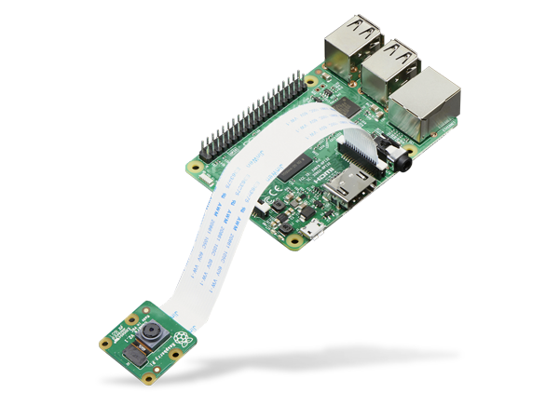

Lightweight model architecture
Prototype detector using Raspberry Pi

Slide 34
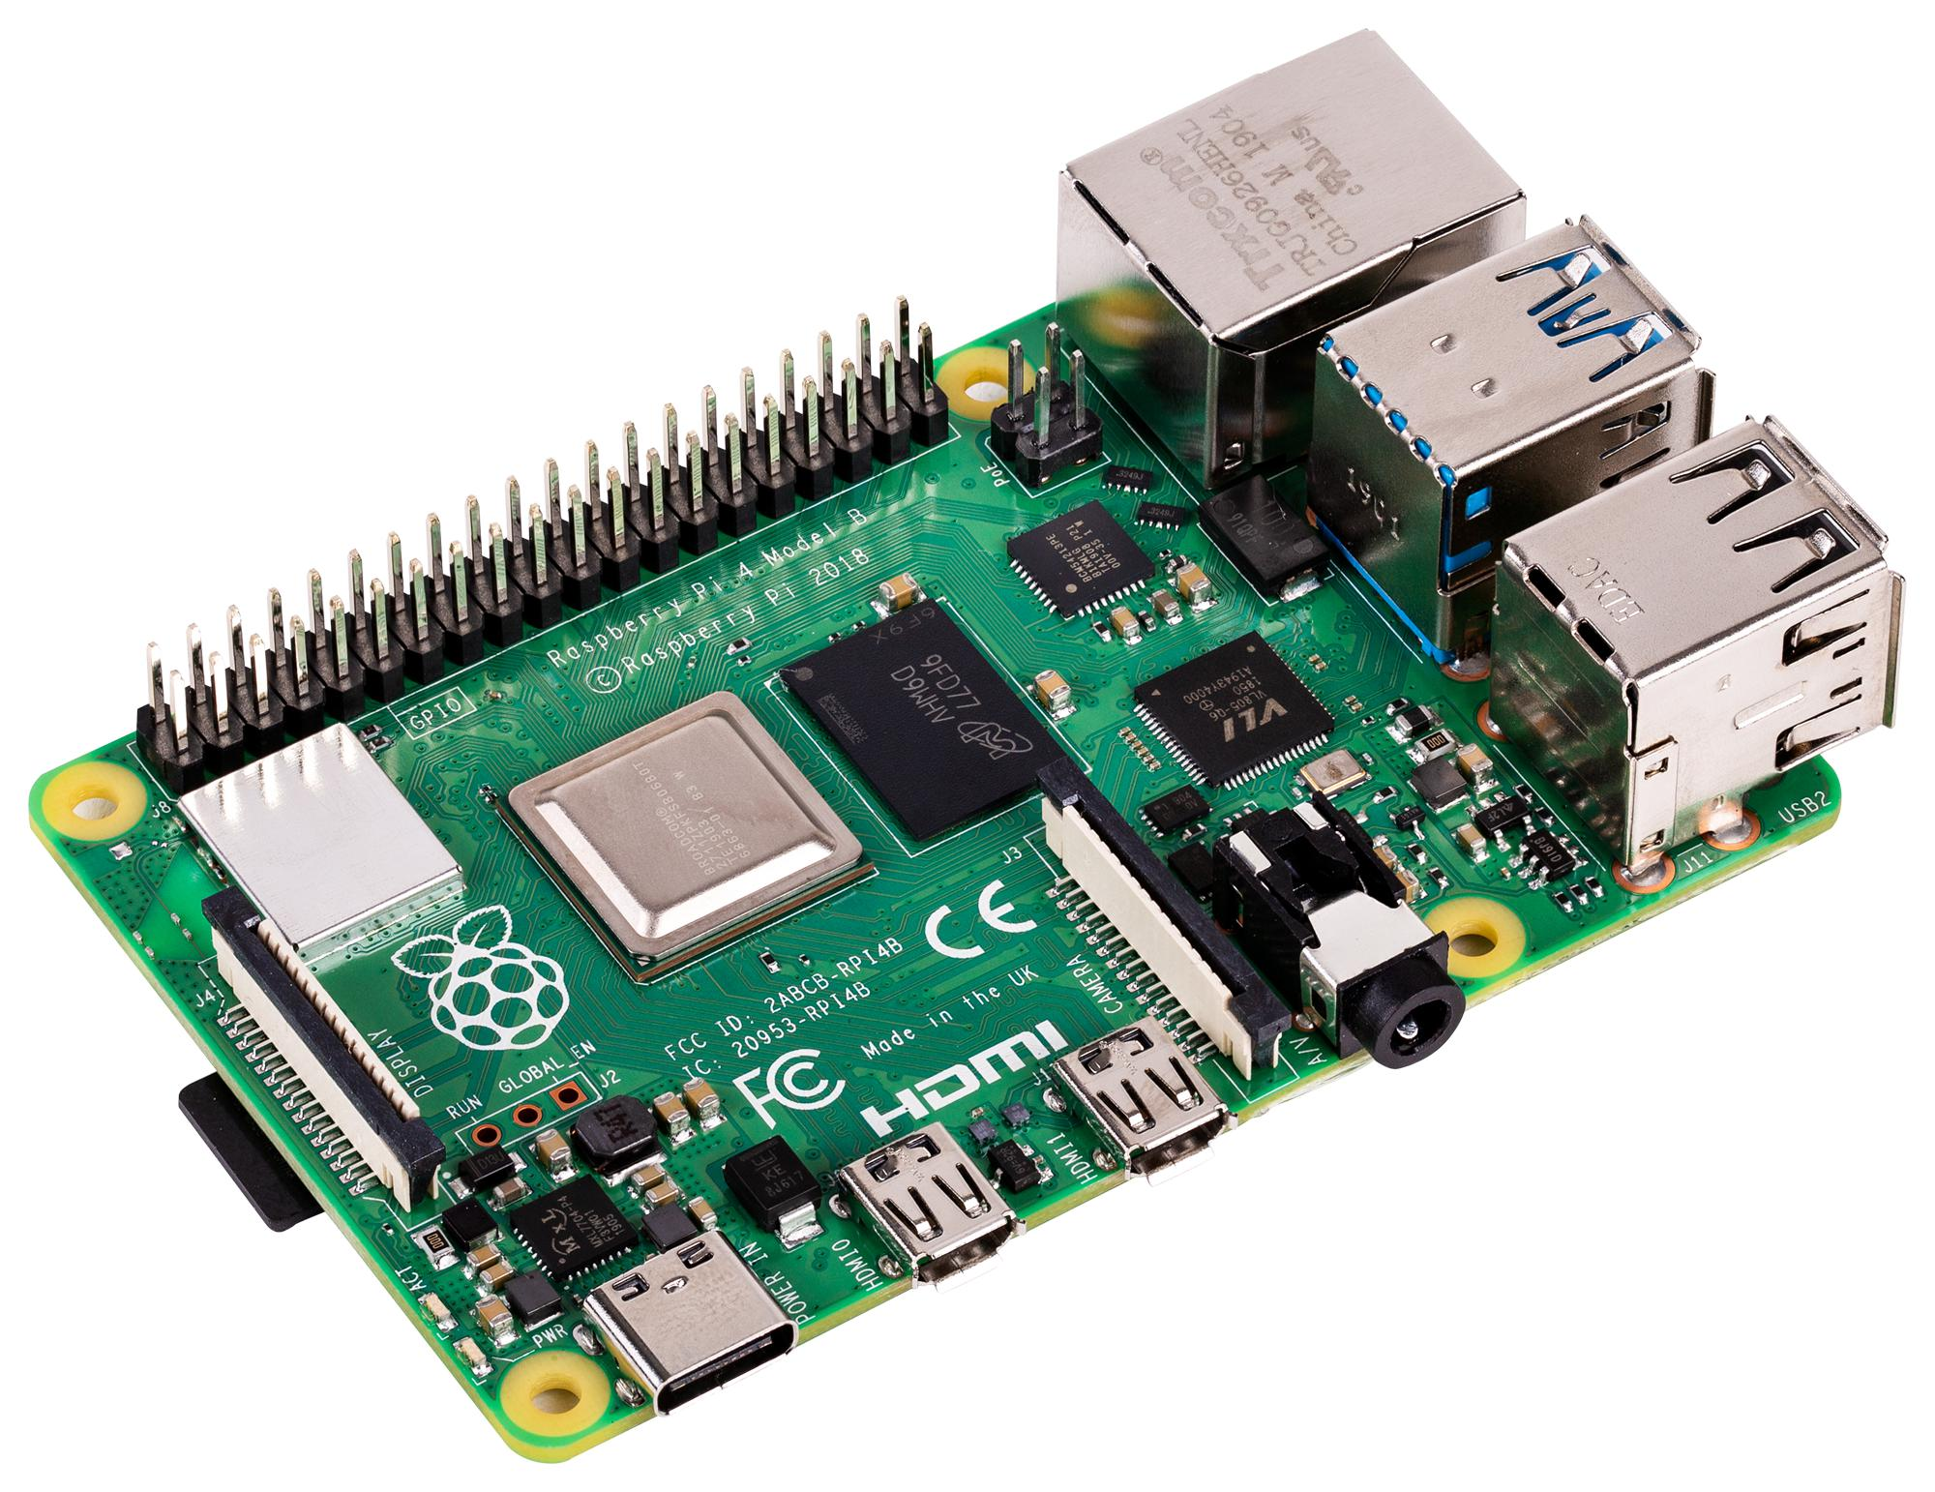
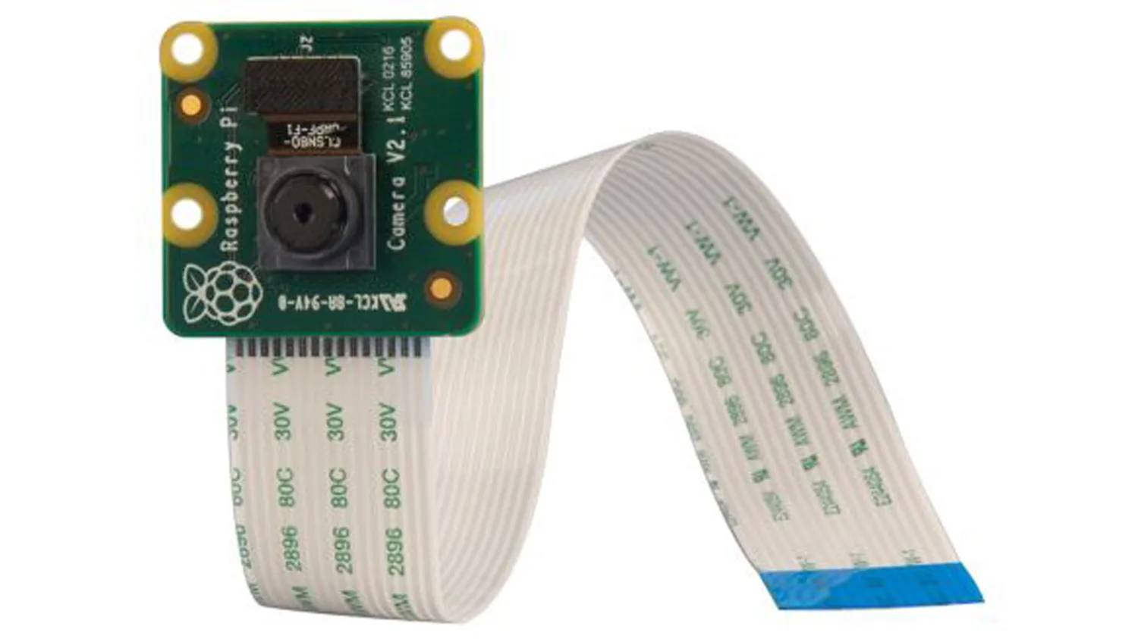
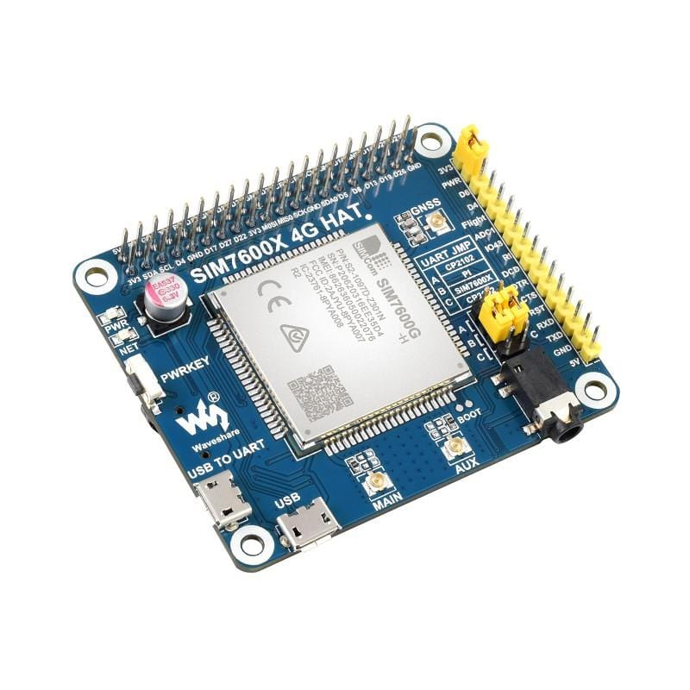
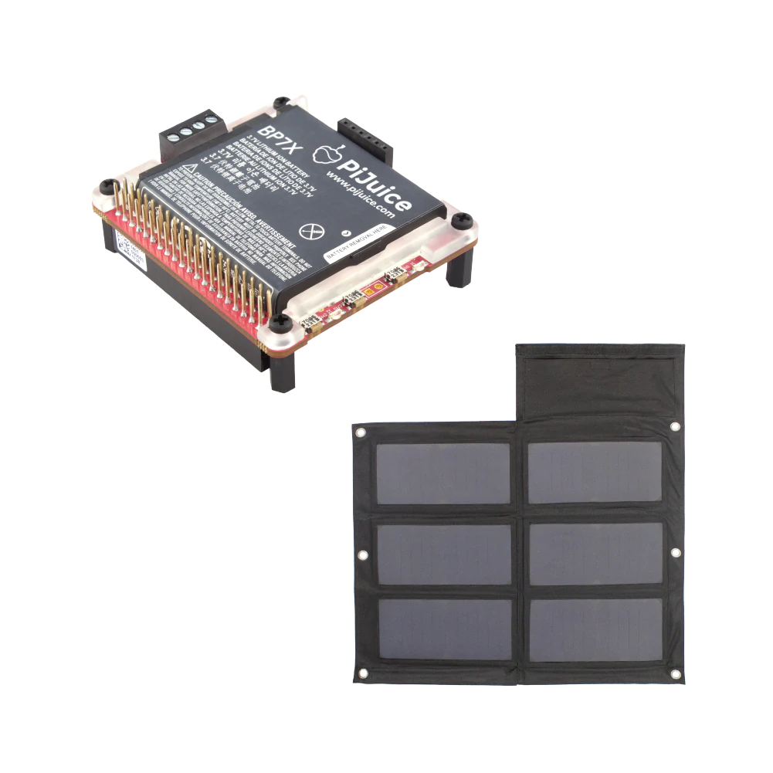
Shopping list
Raspberry Pi 4 Model B £45-55; 2-4GB RAM
Camera module V2.1 £24.90
Connectivity: 4G HAT £64.50
Power: PiJuice Solar kit (Solar panel + battery + HAT) £89.99-187.49; 6-40 Watt panel
£214.39-331.89

Slide 35
The End

